Slide 1
DegreeWorks 5 Operation Guide
(Advisors/Administrators)
OCIO
Oct 2022

Slide 2
Contents
Login and access DegreeWorks
Features of DegreeWorks
Degree Audit
Student View
Registration Checklist
Class History
Request for reviewing and updating audit report
Features of DegreeWorks
What If
Look Ahead
Student Educational Planner (SEP)

Slide 3
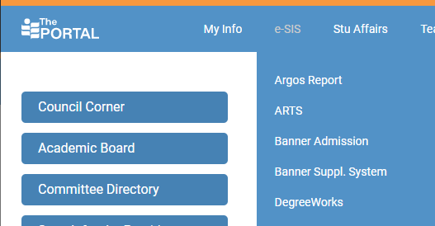
Login and Access DegreeWorks
The Portal > e-SIS > DegreeWorks > Login with your EdUHK network account

Slide 4
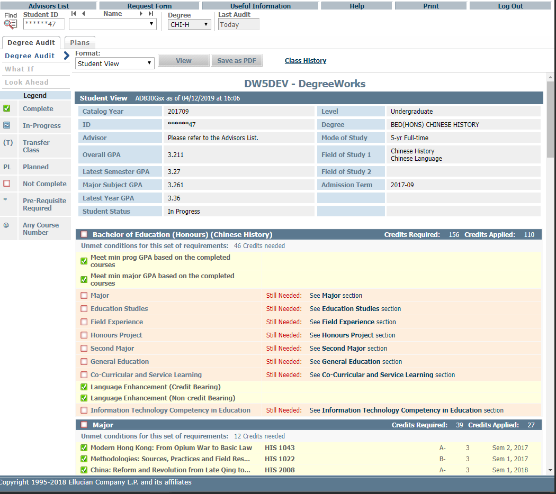
DegreeWorks web Interface
Functional buttons
Search a student
Tabs
Blocks

Slide 5
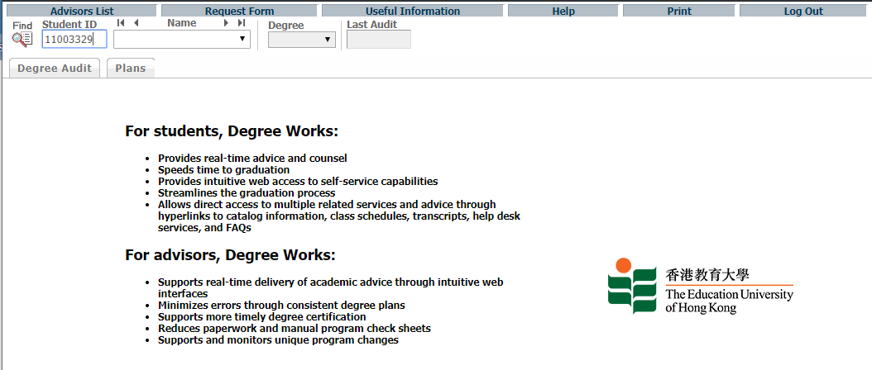
Degree Audit (administrative staff)
To find a student, input the student ID and hit enter
Input Student ID & press enter

Slide 6
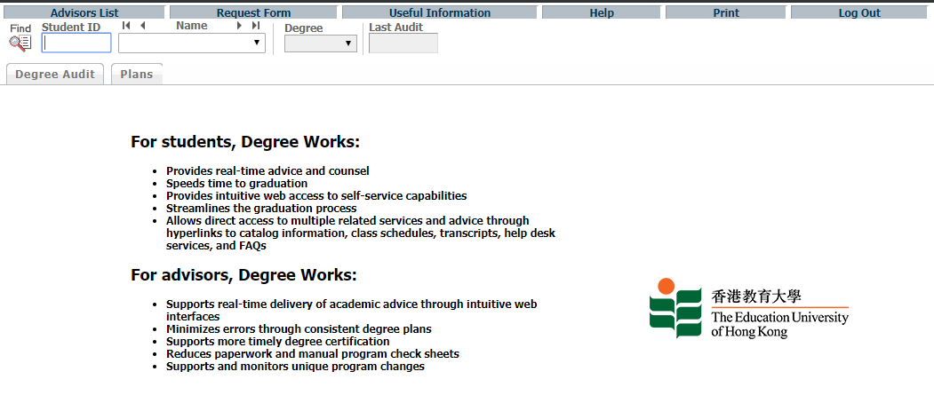
Degree Audit (administrative staff)
Or click the Find button
Find button

Slide 7
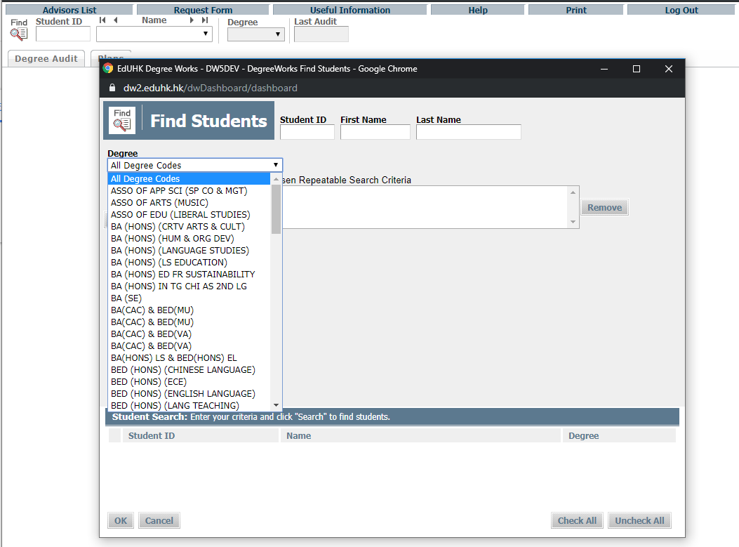
Degree Audit (administrative staff)
A search window pops up
Input search criteria
and Search

Slide 8
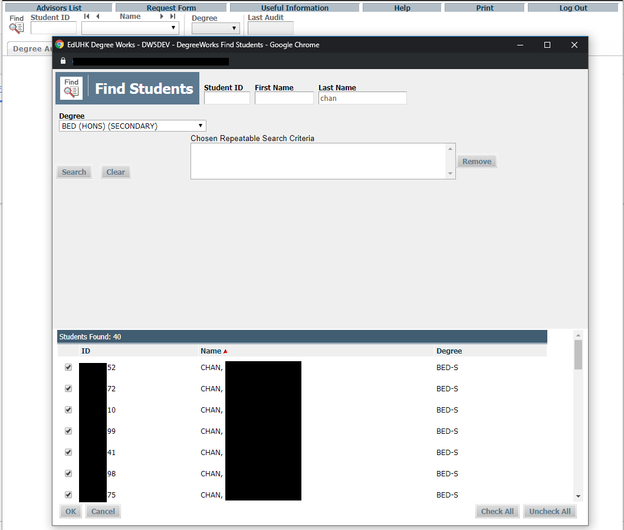
Degree Audit (administrative staff)
Click to check or uncheck all students
The pop-up window will close and the short-listed students will appear in the pull-down menu at the top.
Click to sort students by ID, Name or Degree
Check to select students, then click OK.

Slide 9
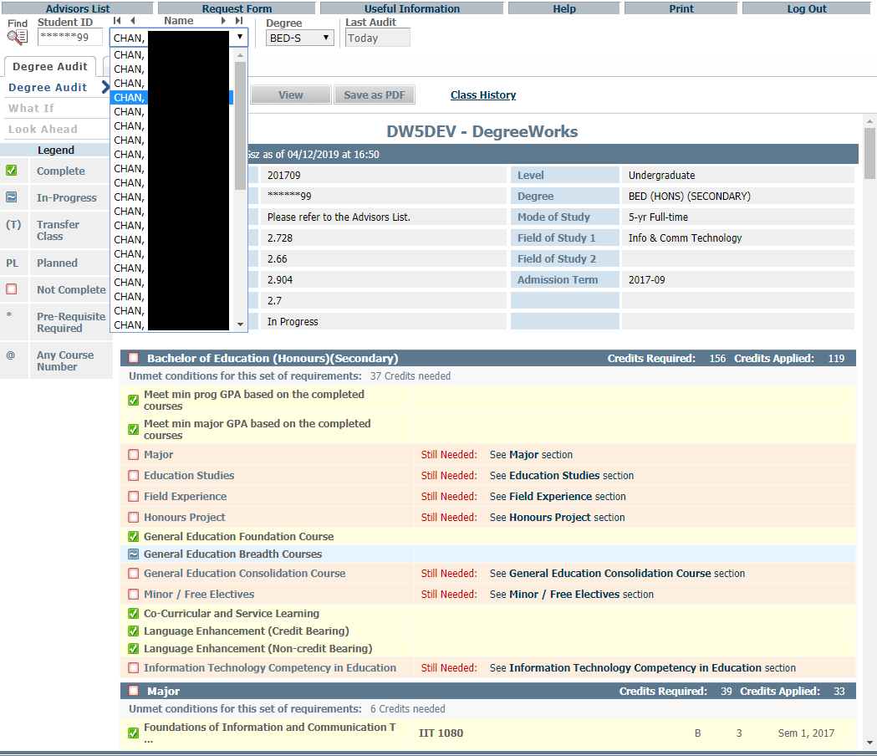
Degree Audit (administrative staff)
Click the pull-down menu and choose the student

Slide 10
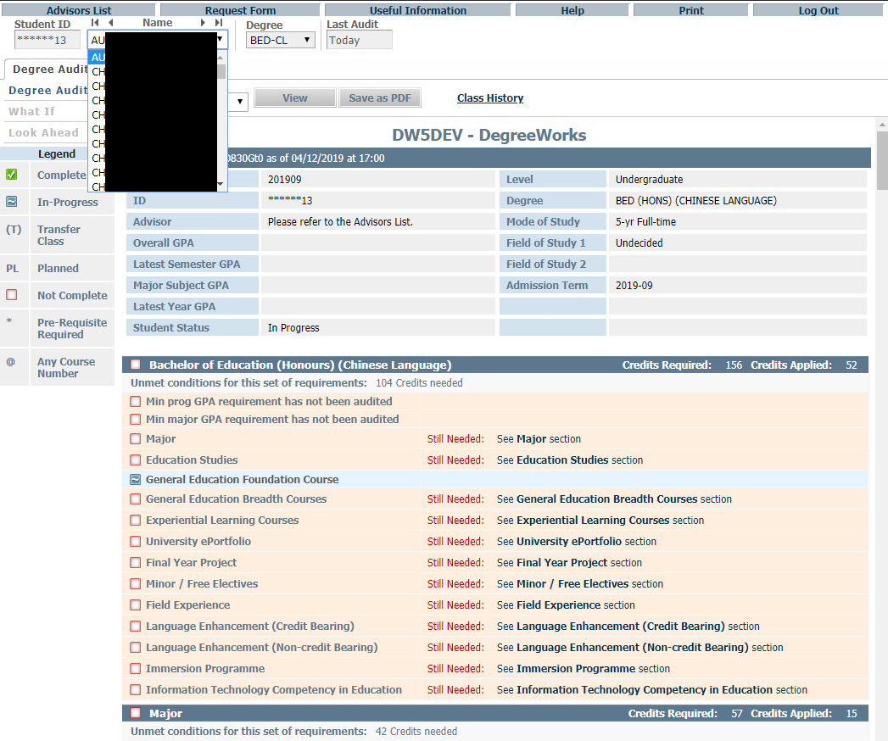
Degree Audit (academic advisors)
DegreeWorks pre-loads your list of advisees.
Click the pull-down menu

Slide 11
Features of DegreeWorks – Degree Audit Reports
Format: Student View (default)
Student View allows advisors and students to quickly and easily identify which requirements have been satisfied, and which requirements are outstanding. The requirements are displayed in blocks.

Slide 12
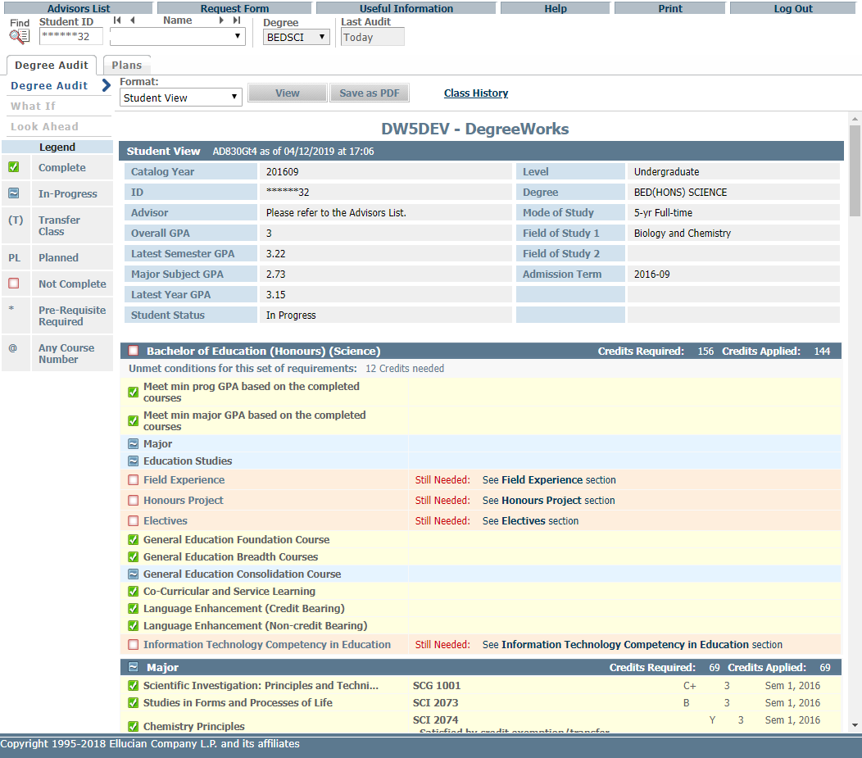
Format: Student View (default)
Student Information
Programme requirement block
Complete
In-Progress
Legend
Not complete
Study Area blocks

Slide 13
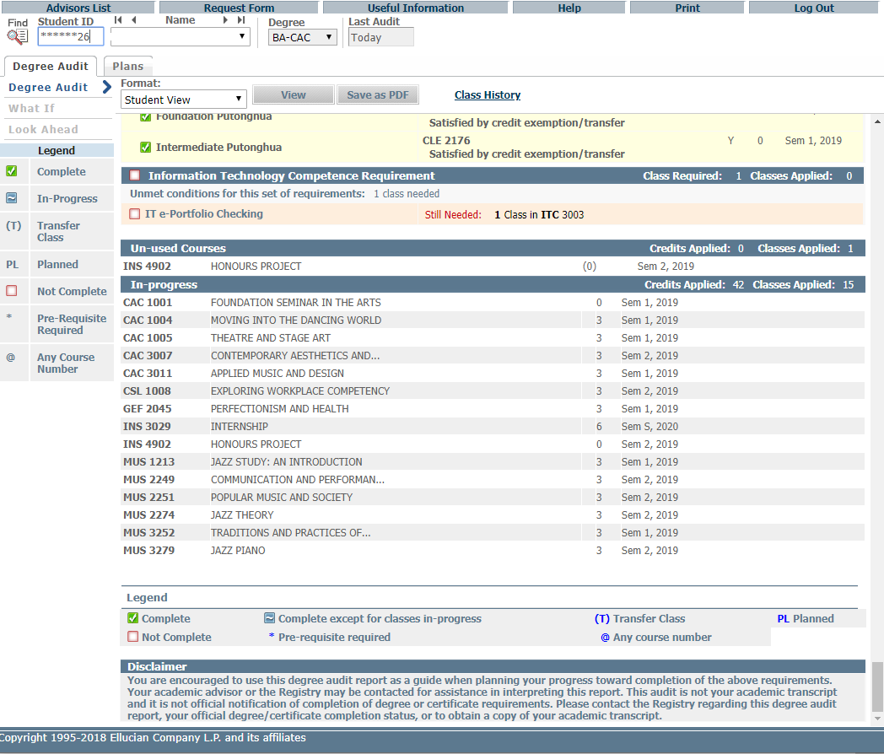
Un-used courses, i.e. courses NOT used to meet any graduation requirements
Misc. Information block
In-progress courses
Legend

Slide 14
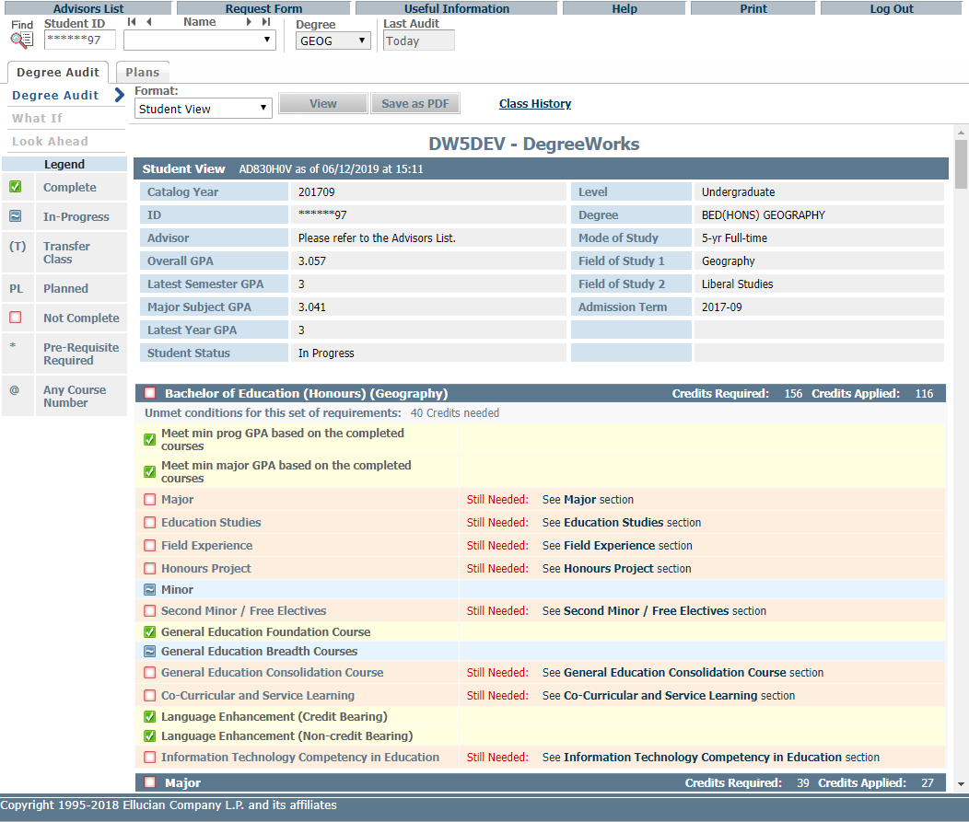
Click “Save as PDF” to save the audit as a PDF

Slide 15
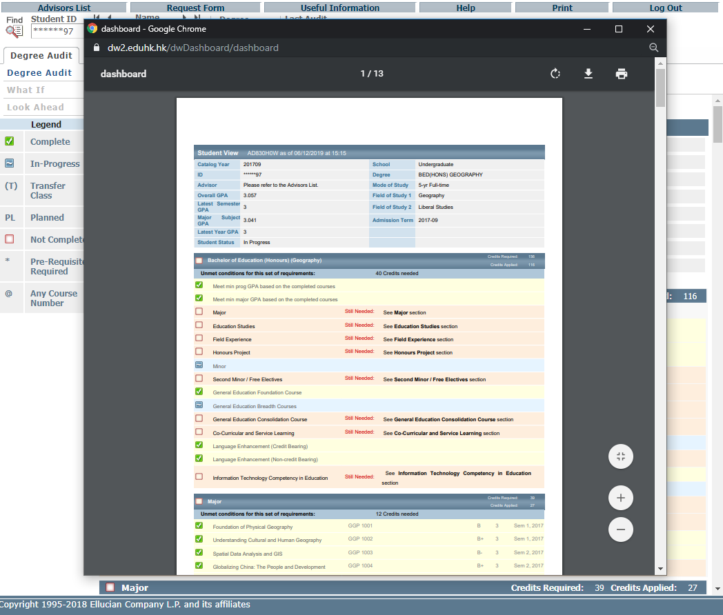
Click to download the PDF file
Click to Print

Slide 16
Features of DegreeWorks – Degree Audit Reports
Format: Registration Checklist
Shows only the unfulfilled requirements that are "Still Needed" on the checklist.

Slide 17
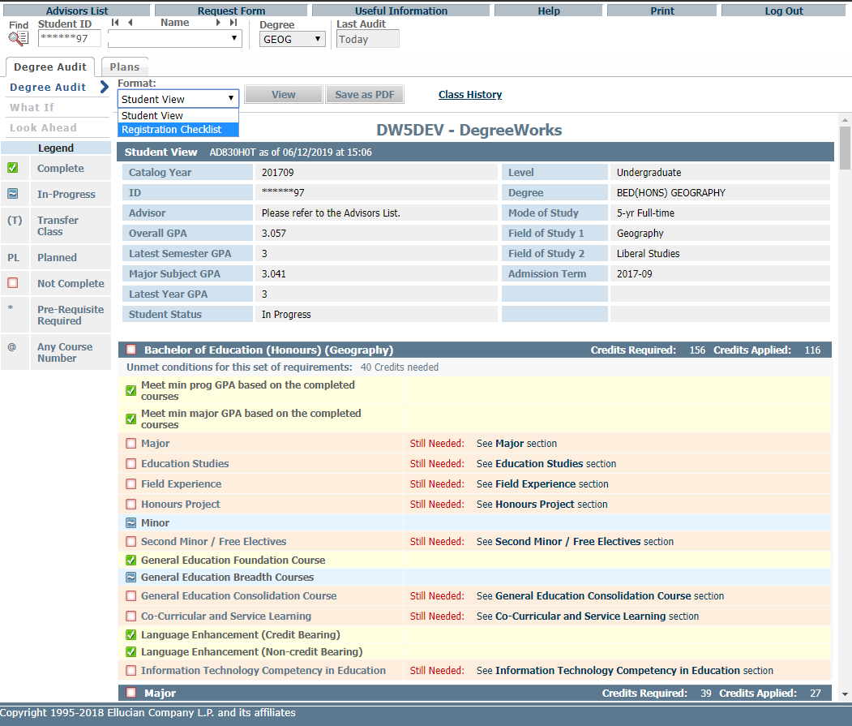
Click on the pull down menu, choose a format and press “View”

Slide 18
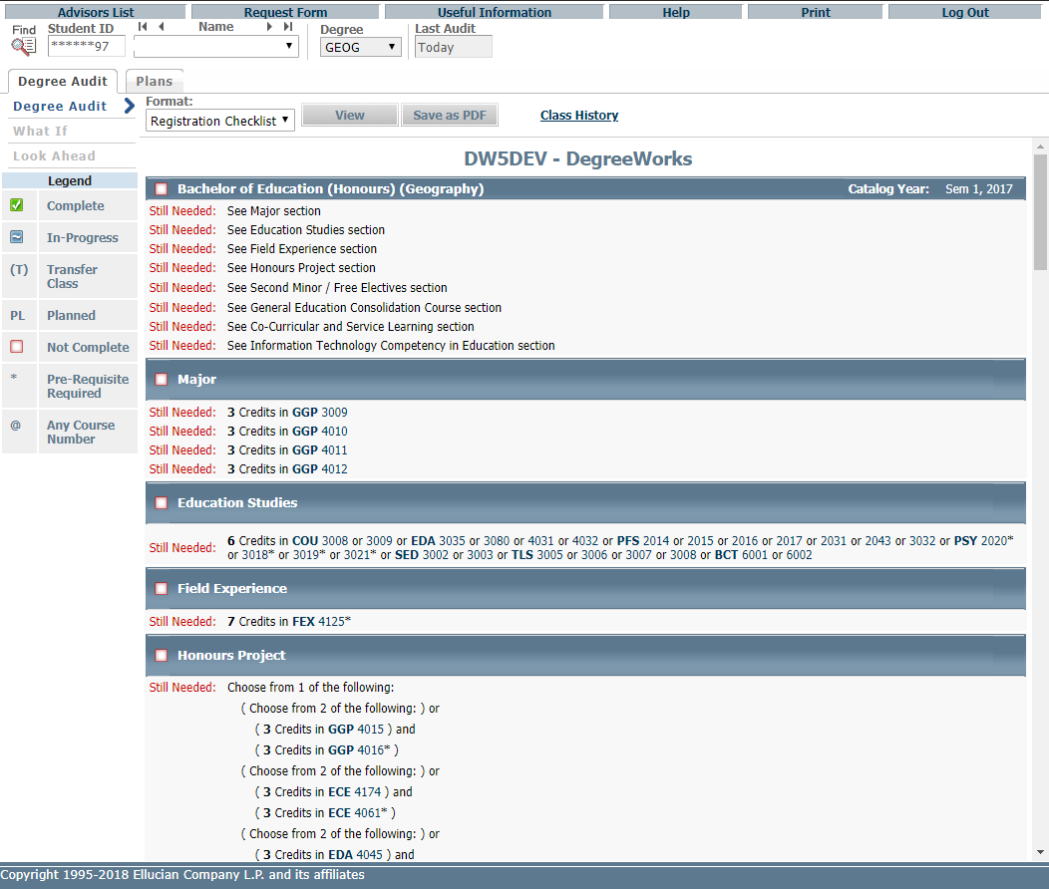
Registration Checklist
Courses still needed

Slide 19
Features of DegreeWorks – Class history
Provides a listing of all of the courses taken by the student, with grades and credits, grouped by the semester taken.

Slide 20
Features of DegreeWorks – Class history
Class History

Slide 21
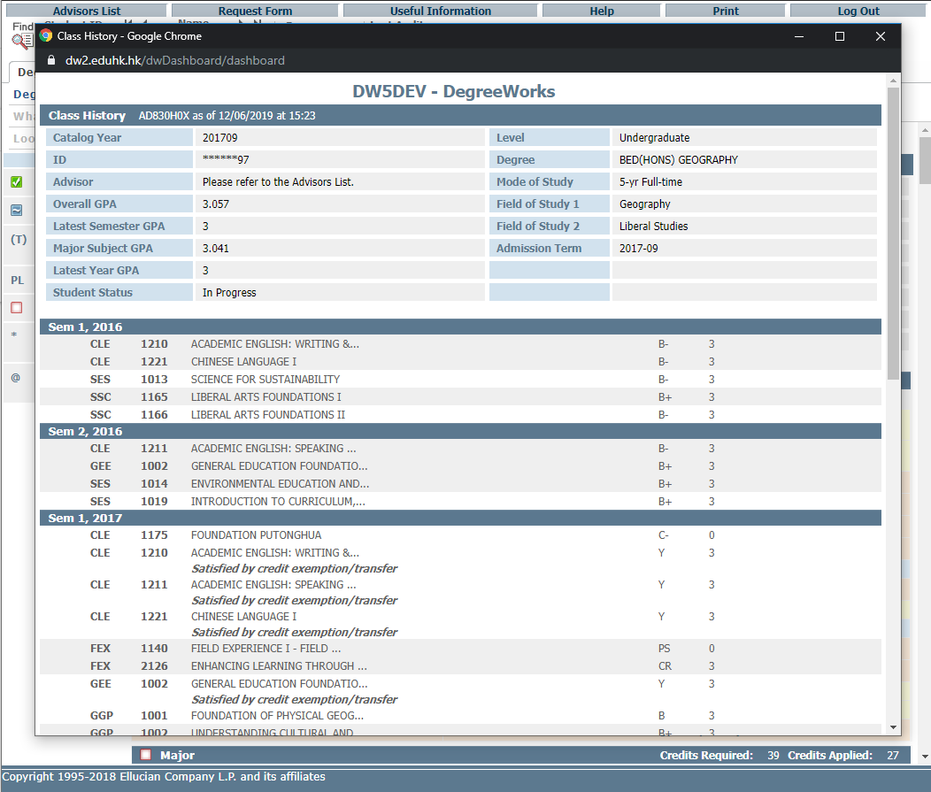
Listing of courses, grades and credits in chronological order

Slide 22
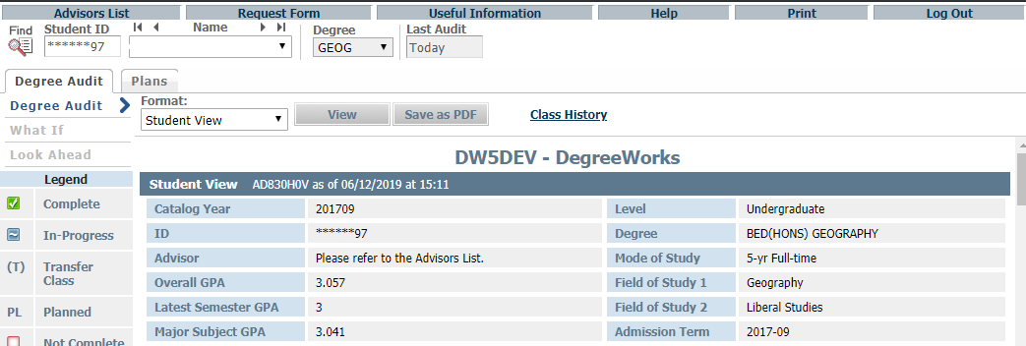
Request for reviewing and updating audit report
If the degree audit report is found incorrect or outdated, students can request the Registry to review and update the record by filling in a DegreeWorks request form which could be downloaded from clicking “Request Form” as follows.

Slide 23
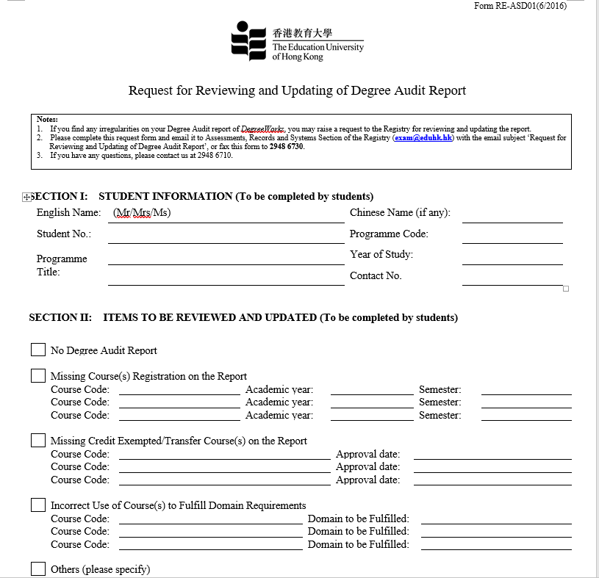
Complete the form and send email to Registry exam@eduhk.hk

Slide 24
Features of DegreeWorks – What If
The “What-if” function shows students how progress towards degree completion changes if they add a Second Major / Minor or change majors. It can also include unregistered classes that the students plan to take in the future.

Slide 25
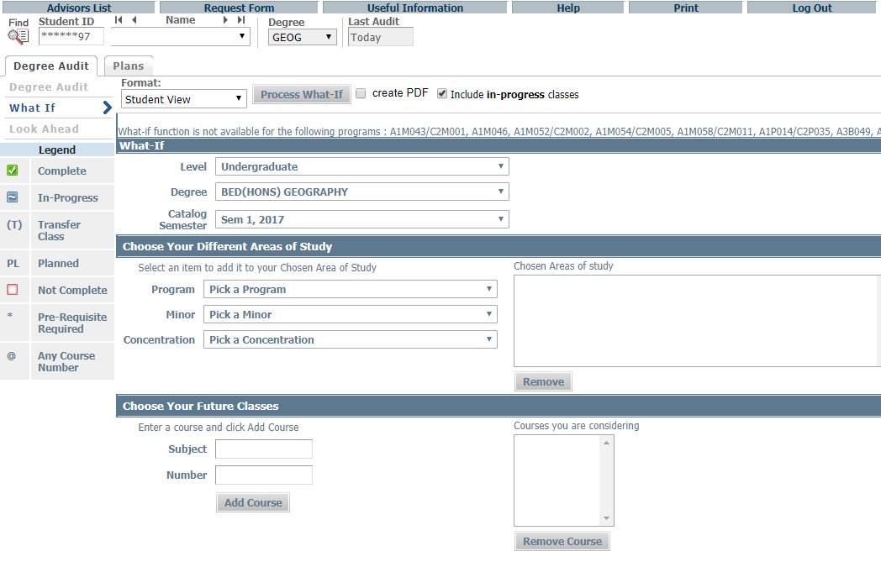
Features of DegreeWorks – What If
What If

Slide 26
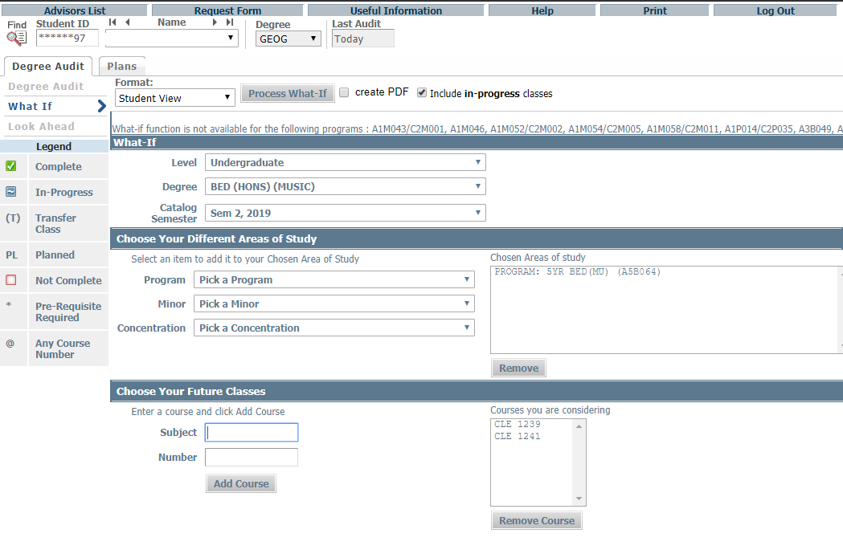
Click Process What-If
Chosen Areas of study show up here
Choose level, degree, catalog semester, program and major, minor and concentration where applicable
Enter subject code and number, click Add Course
Chosen Courses show up here

Slide 27
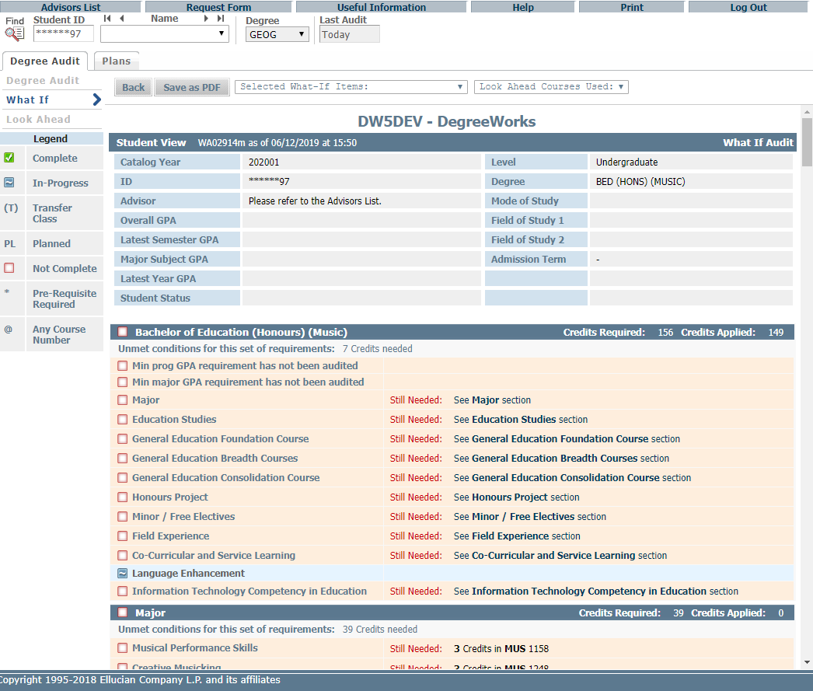
The “What-if” audit shows students how progress towards degree completion changes if they add a Second Major / Minor or change majors.

Slide 28
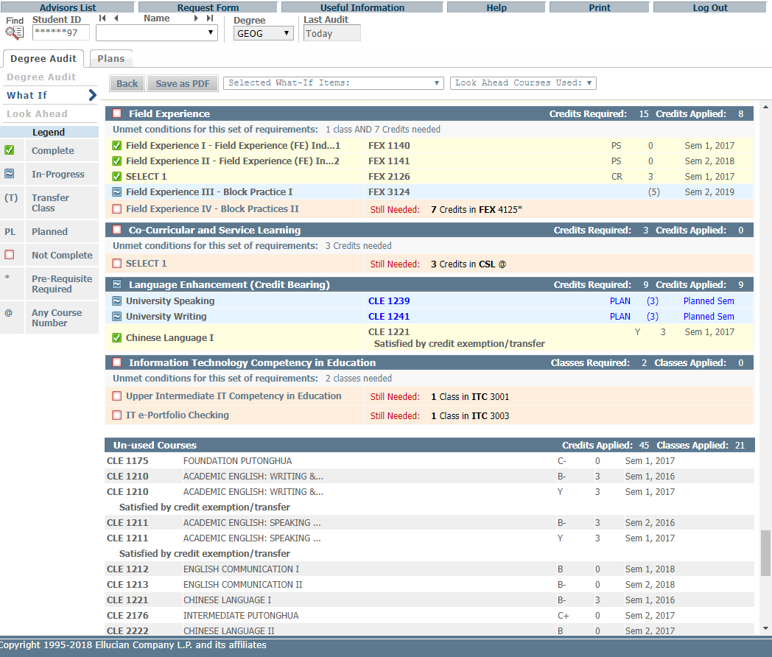

Slide 29
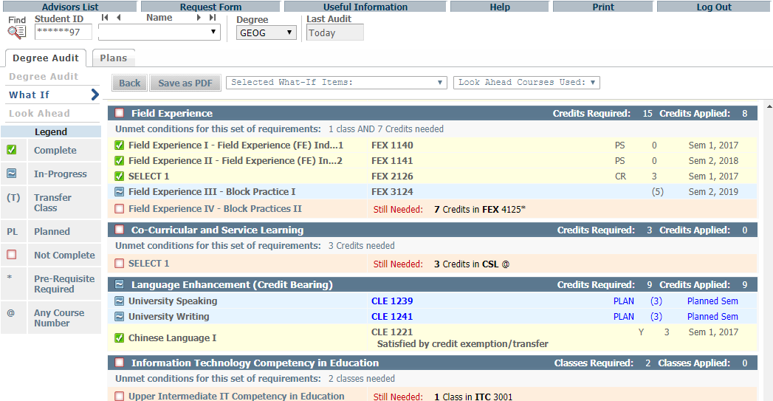
Click Save as PDF button to save/print What-If Audit
What-If Audits are not stored in the database. After they are run, the results can be saved or printed using the Save as PDF button. Navigating away from What-If screen the audit cannot be accessed again. It is possible to run another What-If Audit with the same parameters.
Click “Save as PDF”

Slide 30
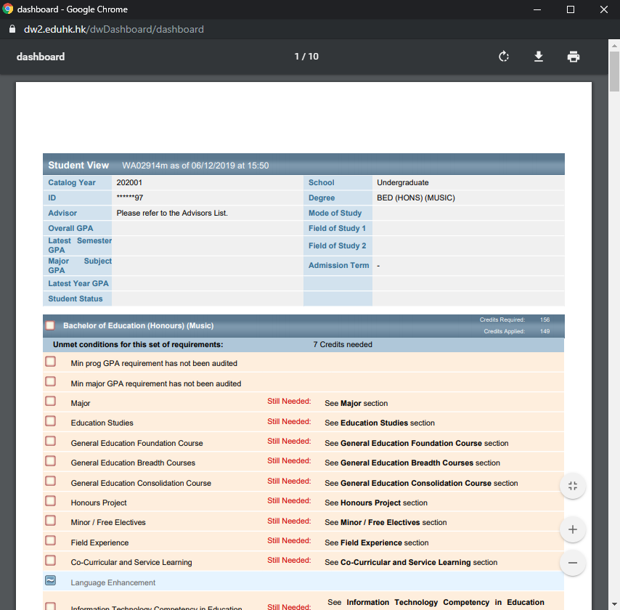

Slide 31
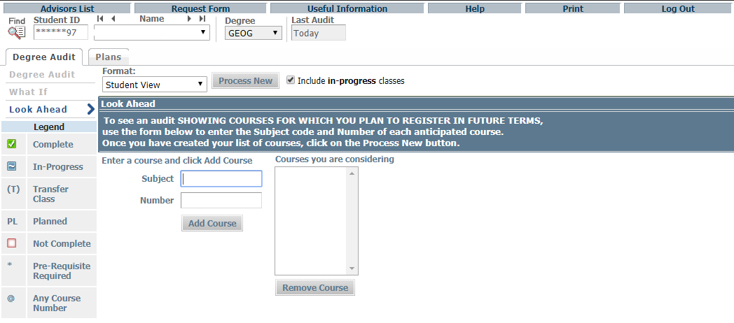
Features of DegreeWorks – Look Ahead
The Look Ahead allows the audit to include unregistered classes the student plans to take in the future.
Look Ahead

Slide 32
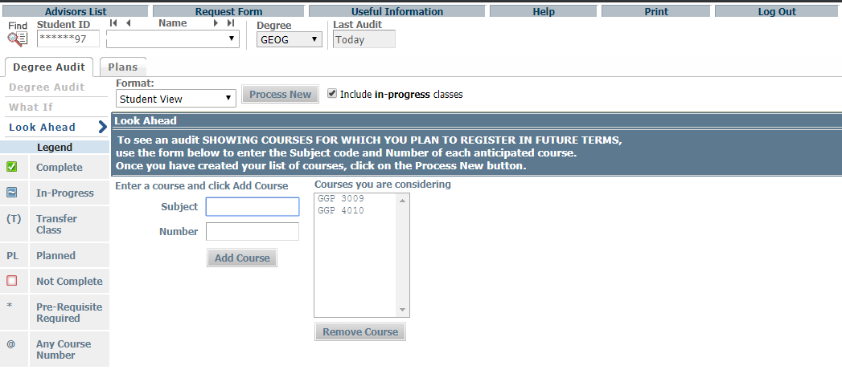
Repeat entering subject(s) and number(s), if needed.
Click Process New
Chosen Courses show up here
Enter subject code and number, click Add Course

Slide 33
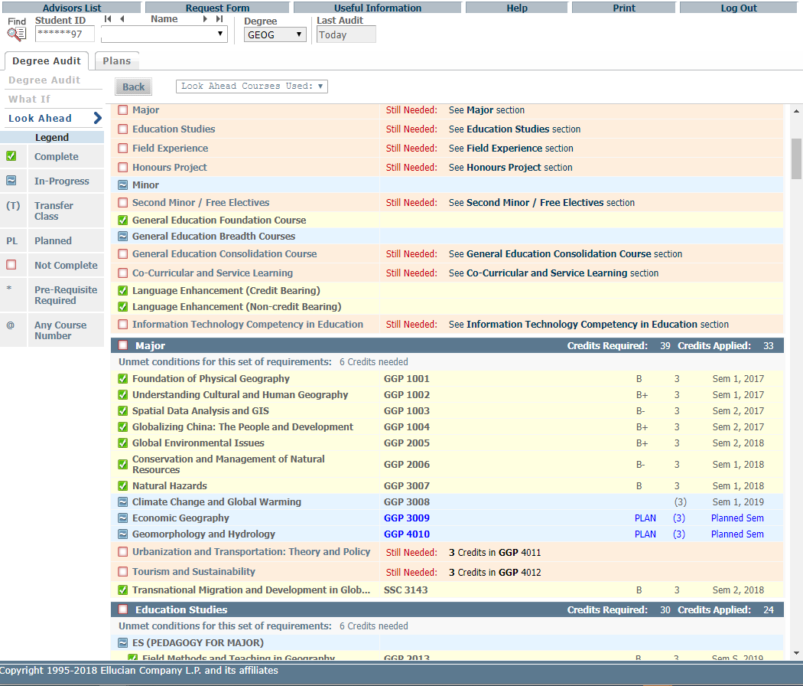
Courses will be marked with “Planned Sem” in the Look Ahead Audit report.

Slide 34
It is important to remember that these Look Ahead audits are not saved, but can be printed and run again.
Print

Slide 35
Features of DegreeWorks – Student Educational Planner (SEP)
Academic and teaching staff will play the role of academic advisors.
They meet students at least once during their first year of study and assist students with various aspects of their learning experience and render Professional Advice.
DegreeWorks is designed to aid and facilitate academic advising, but is not intended to replace face-to-face advising sessions. For details, please visit https://www.eduhk.hk/advising.
Important Note: The old DegreeWorks 4 supported a total of 50 lines of Notes per plan, each line with a maximum of 72 bytes, including spaces at the end of lines. That’s a total of 3600 bytes. And the all-over max size of the plan, including all course information and notes, is 10K. The new Student Educational Planner (SEP) in DegreeWorks 5 does not have these limitations.

Slide 36
Features of DegreeWorks – Student Educational Planner (SEP)
Edit View
(for Academic Advisors)

Slide 37
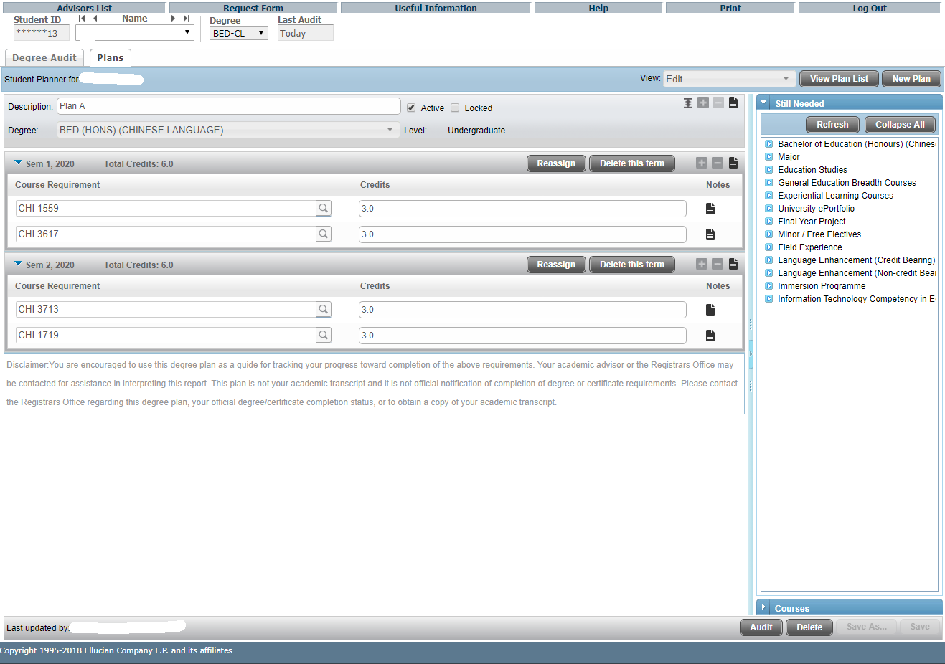
Click “Plans” tab to access the Student Educational Planner (SEP)
With Edit View as the default view, student records with no plan in place, as well as student records with one or more plans in place, will see their plan or plans in Edit View. The student cannot have more than 1 active plan.
The right-hand panel of the Edit view provides options for “dragging and dropping” coursework to the plan. The “Still Needed” view provides course information from the student audit, whereas the “Courses” view provides a Catalog inventory listing. These can be especially helpful when starting from a blank plan.
An unlimited number of notes can be added to requirements, terms or to the overall plan.

Slide 38
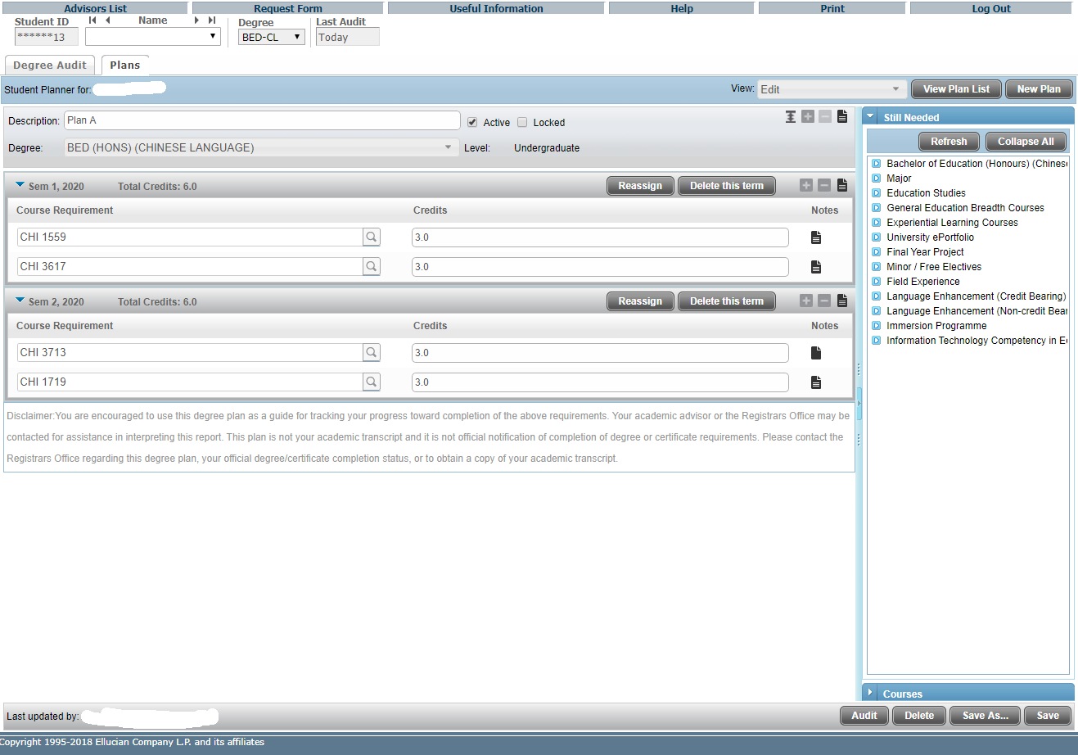
Overall Plan Information
There are course requirements under the terms.
Under the Plan, there are different terms.

Slide 39
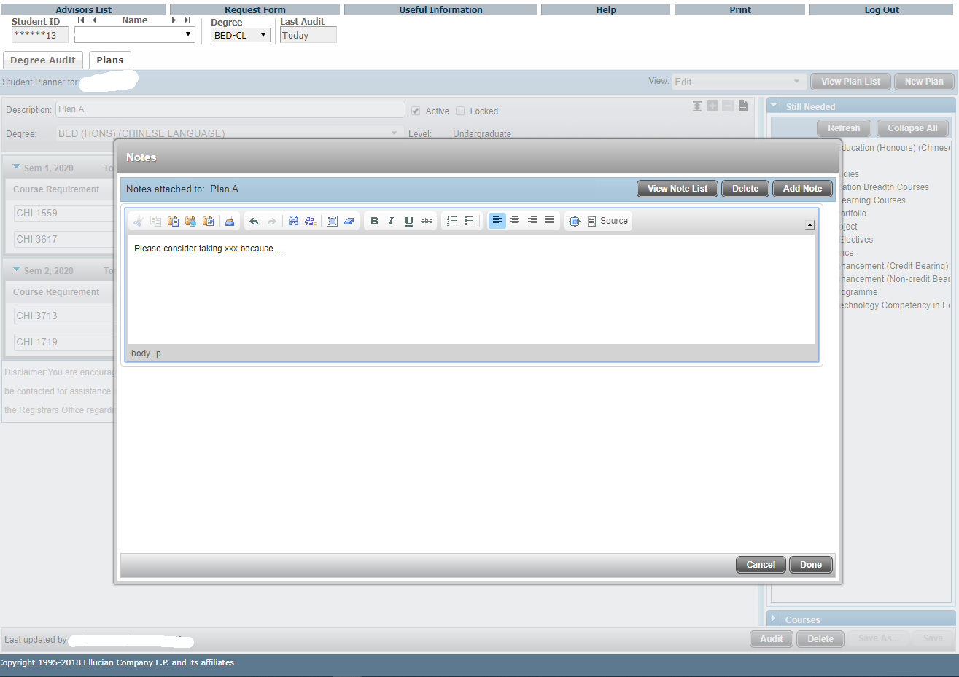
You can leave comment in Plan-level notes (English only) using this button to add a note or edit/delete notes you have created.
After clicking “Add Note”, you can type your text in English and then click “Done” to finish.

Slide 40
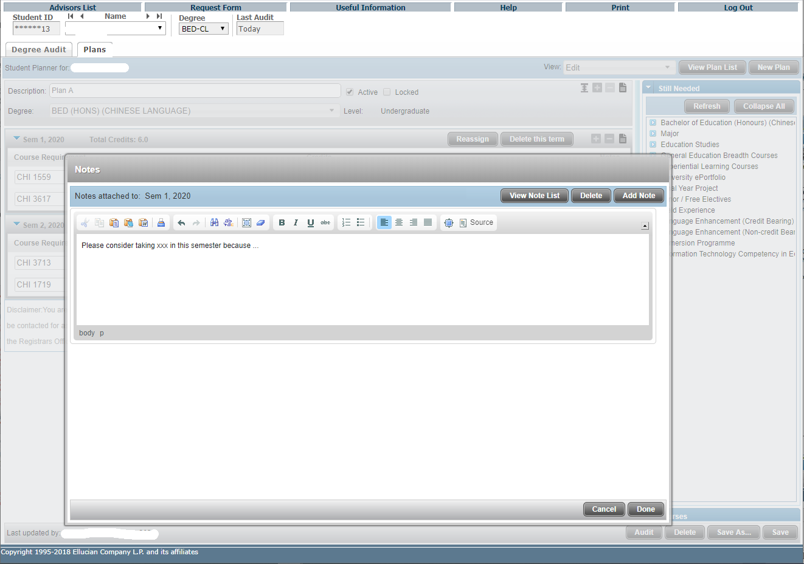
You can also leave comment in term-level notes (English only) using this button to add a note or edit/delete notes you have created.
After clicking “Add Note”, you can type your text in English and then click “Done” to finish.

Slide 41
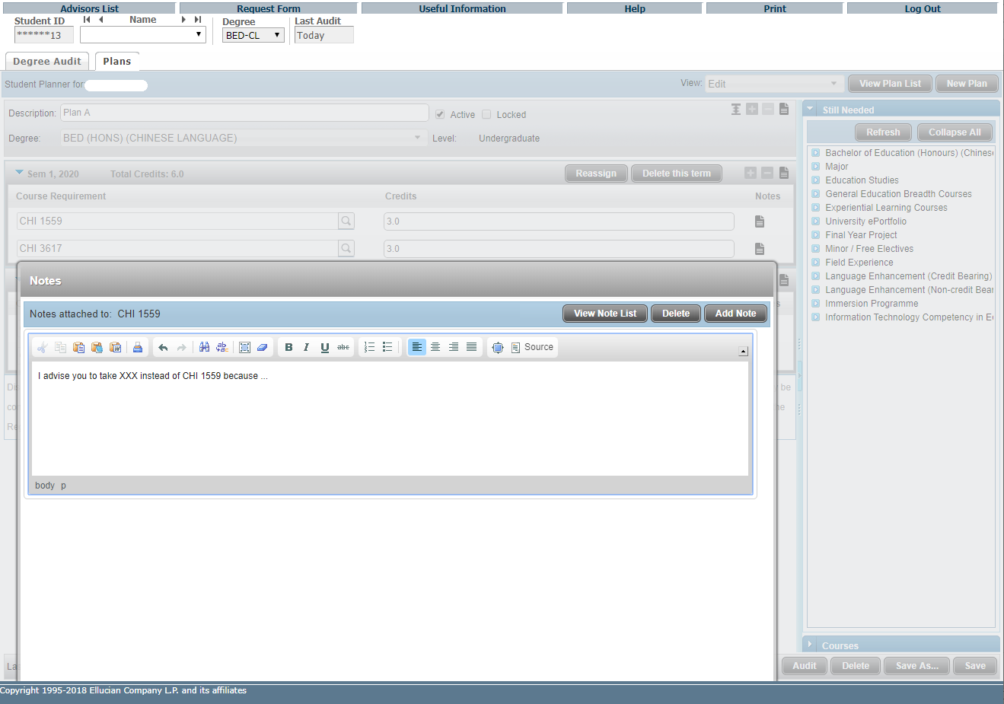
You can leave comment to each course requirement in requirement notes (English only) using this button to add a note or edit/delete notes you have created.
After clicking “Add Note”, you can type your text in English and then click “Done” to finish.

Slide 42
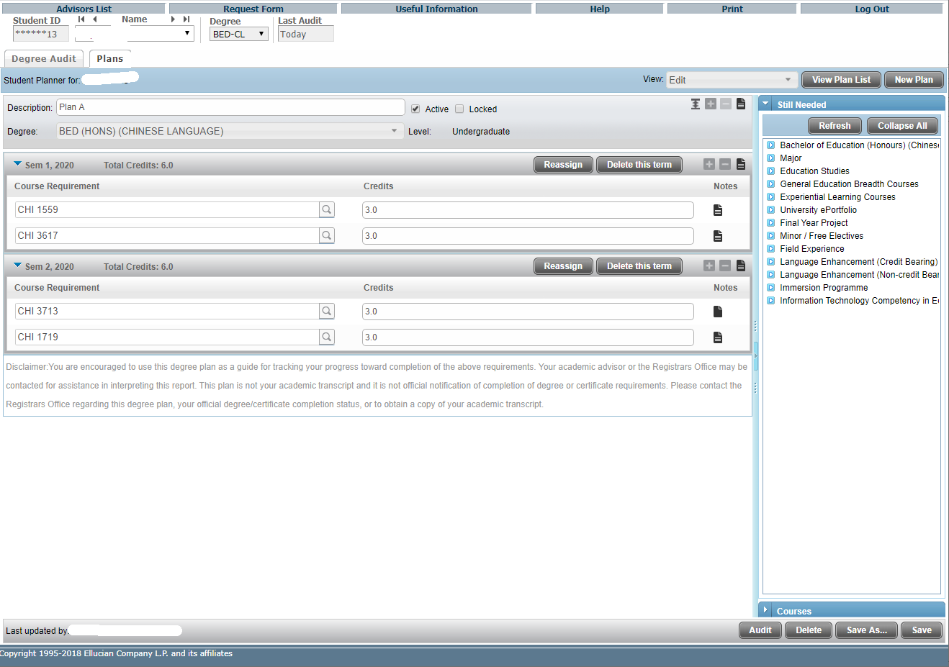
After making any changes to a Plan in Edit View, save those changes and then click on the Audit button in Edit View before leaving this View.
Or click “Save As …” if you want to save it as another plan instead of overwriting.

Slide 43
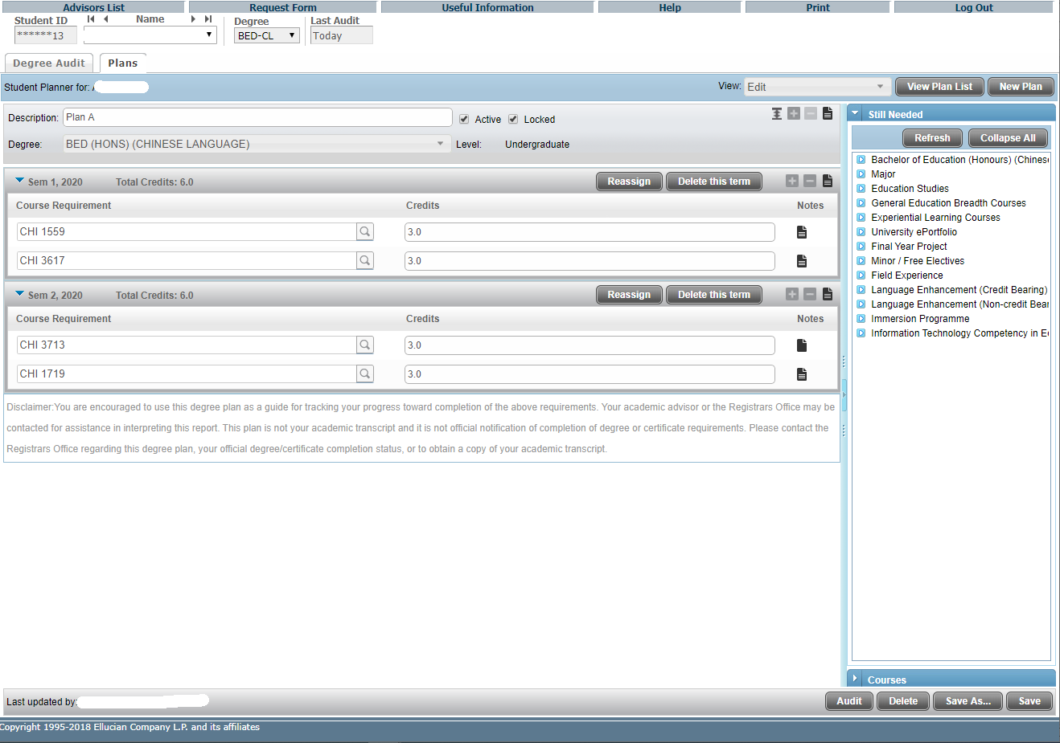
You can lock a plan, for example, before you meet the student in next meeting. Students cannot edit a locked plan, but they can save it as a new one and edit.
Click "Save" to finish.

Slide 44
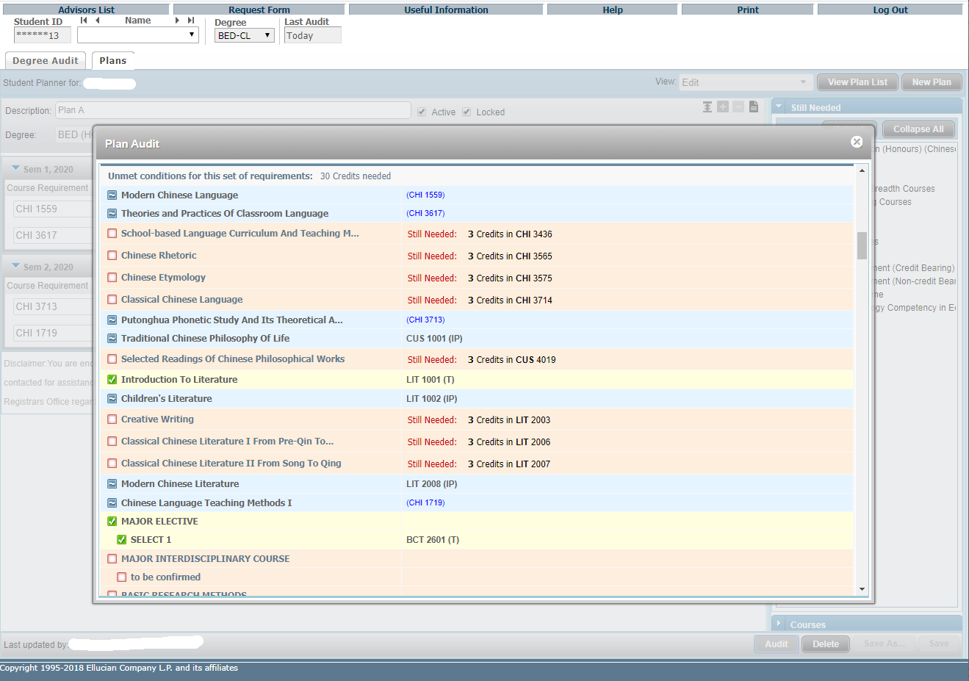
As soon as a plan opens in Edit View, click the Audit button to generate a Plan Audit, which will display all courses from the Plan in an advising worksheet in an imbedded window.
The planned requirements are highlighted.

Slide 45
Features of DegreeWorks – Student Educational Planner (SEP)
View Plan List

Slide 46
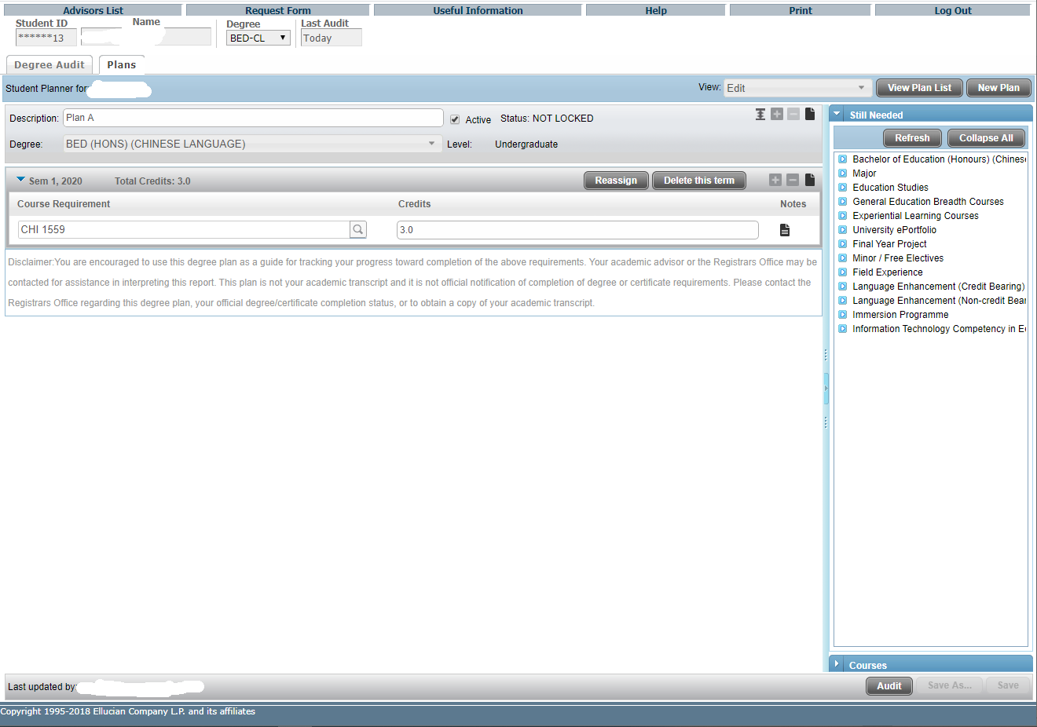
Click “View Plan List” to view the list of your plan(s).

Slide 47
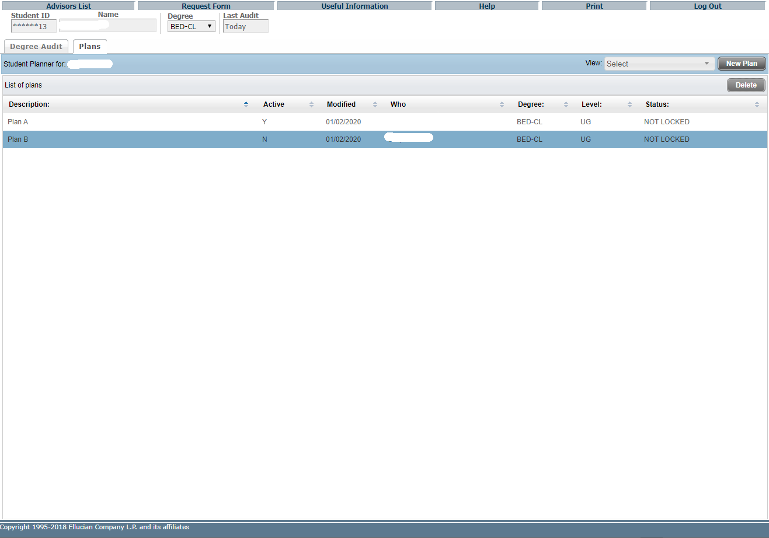

Slide 48
Features of DegreeWorks – Student Educational Planner (SEP)
Calendar View

Slide 49
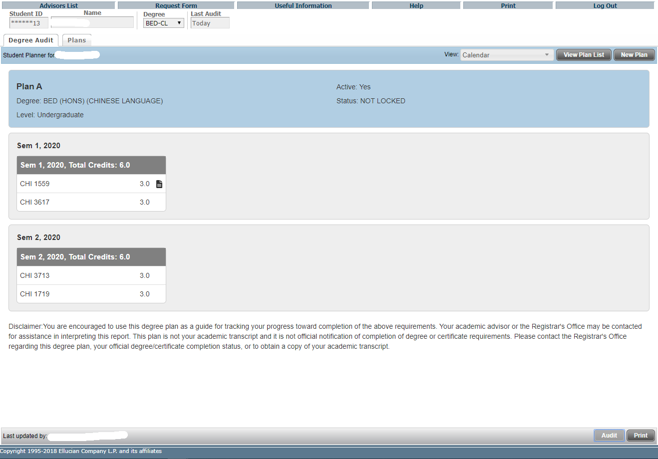
The Calendar view allows the user to view a plan in a view-only calendar presentation that is suitable for printing.
No editing of the plan is available in this view.
Click “Print” button for printing.

Slide 50
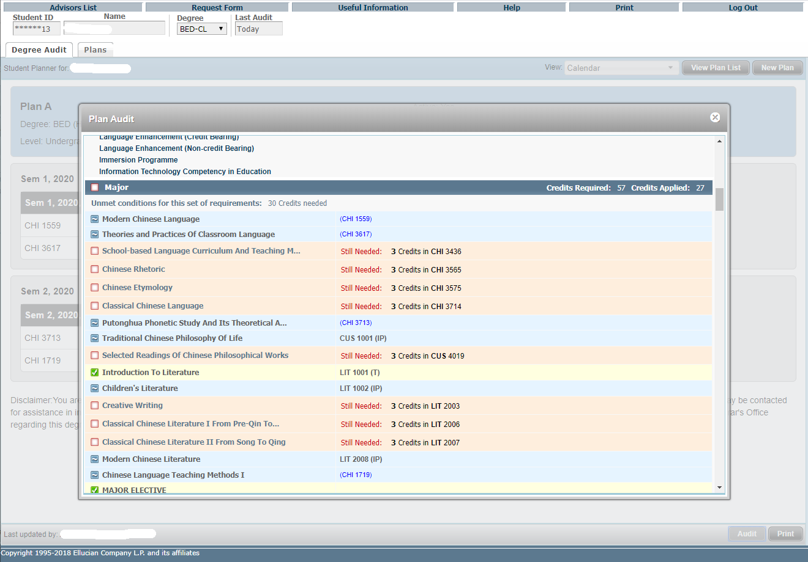
In Calendar View, click the Audit button to generate a Plan Audit, which will display all courses from the Plan in an advising worksheet in an imbedded window.
The planned requirements are highlighted. You can see how far the student is from fulfilling all the degree requirements if the plan is carried out.

Slide 51
Features of DegreeWorks – Student Educational Planner (SEP)
Notes View

Slide 52
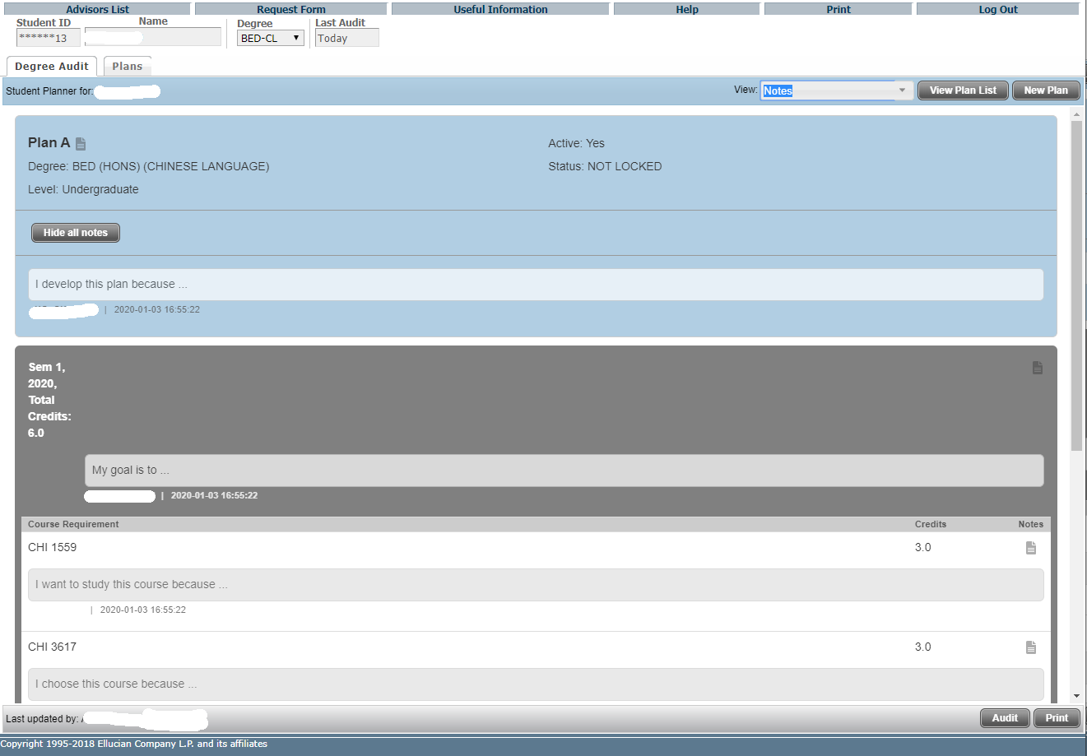
The Notes view allows the user to view a plan in a comprehensive view-only presentation that is suitable for printing, with or without notes inline. No editing of the plan is available in this view.
In the Expanded mode, plan, term and requirement notes display underneath the corresponding item, and will be included when printing. Click “Print” for printing.

Slide 53
Click “Hide all notes” to enter Collapsed mode.

Slide 54
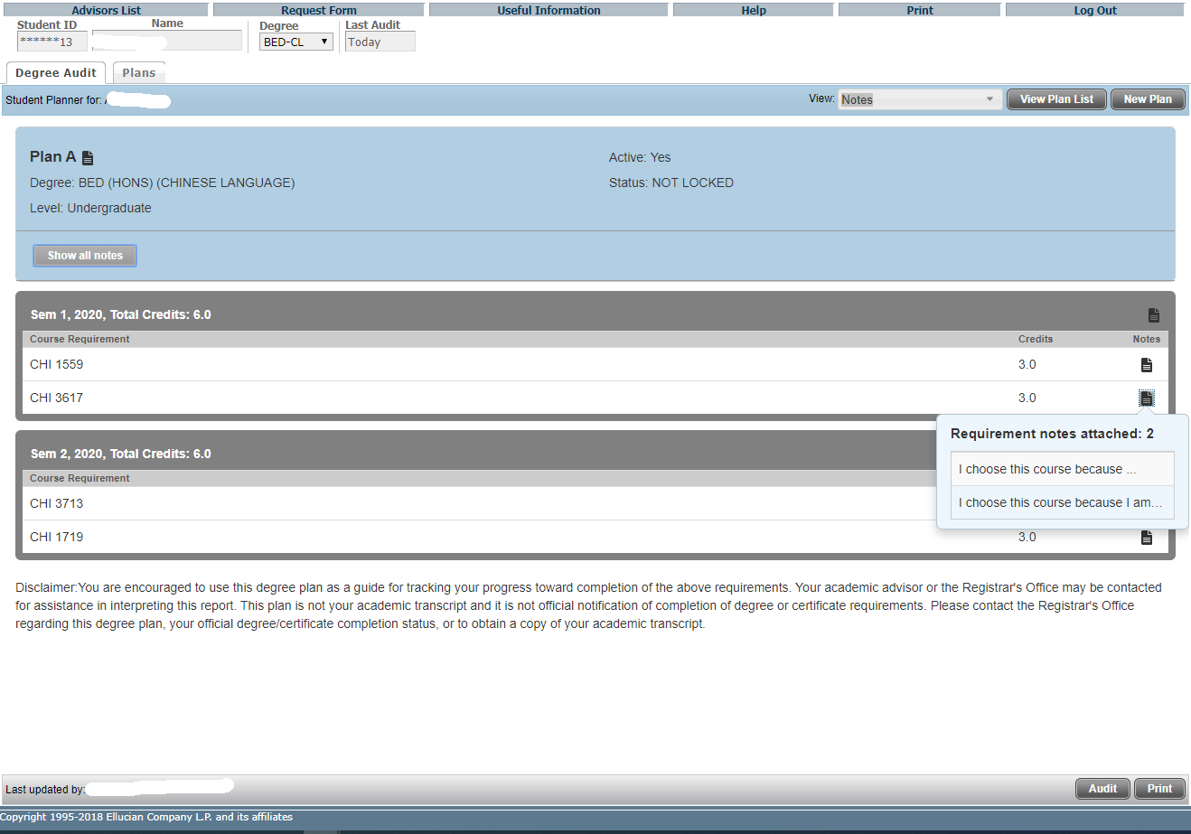
In the Collapsed mode, a note icon will display to the right of that item, but note text will not be included when printing.
Hovering over this icon will show a note preview, and clicking on this icon will open the Notes window.

Slide 55
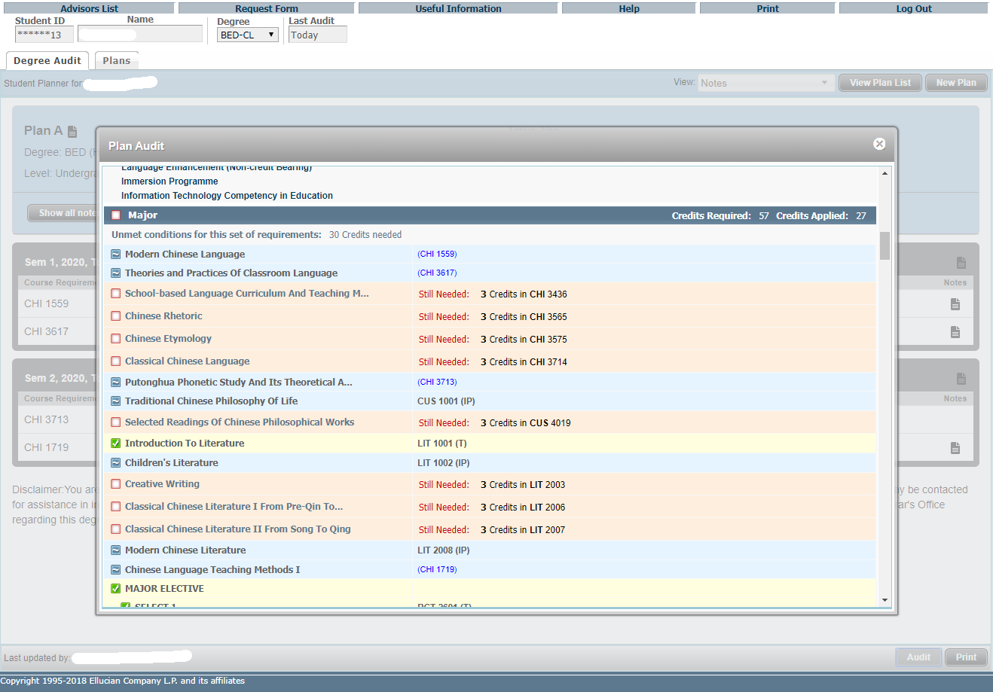
In Notes View, click the Audit button to generate a Plan Audit, which will display all courses from the Plan in an advising worksheet in an imbedded window.
The planned requirements are highlighted.

