Slide 1
DegreeWorks 5 Operation Guide
(Students)
OCIO
Sep - Oct 2022

Slide 2
Contents
Login and access DegreeWorks
Features of DegreeWorks
Degree Audit
Student View
Registration Checklist
Class History
Request for reviewing and updating audit report
Features of DegreeWorks
What If
Look Ahead
Student Educational Planner (SEP)

Slide 3
Login and Access DegreeWorks

Slide 4
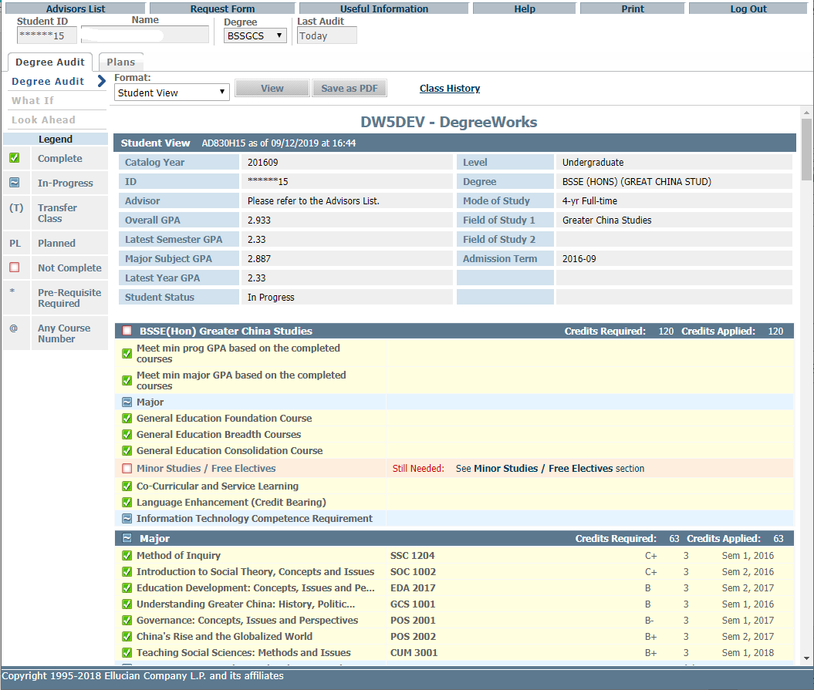
DegreeWorks web Interface
Functional buttons
Tabs
Blocks

Slide 5
Features of DegreeWorks – Degree Audit Reports
Format: Student View (default)
Student View allows advisors and students to quickly and easily identify which requirements have been satisfied, and which requirements are outstanding. The requirements are displayed in blocks.

Slide 6
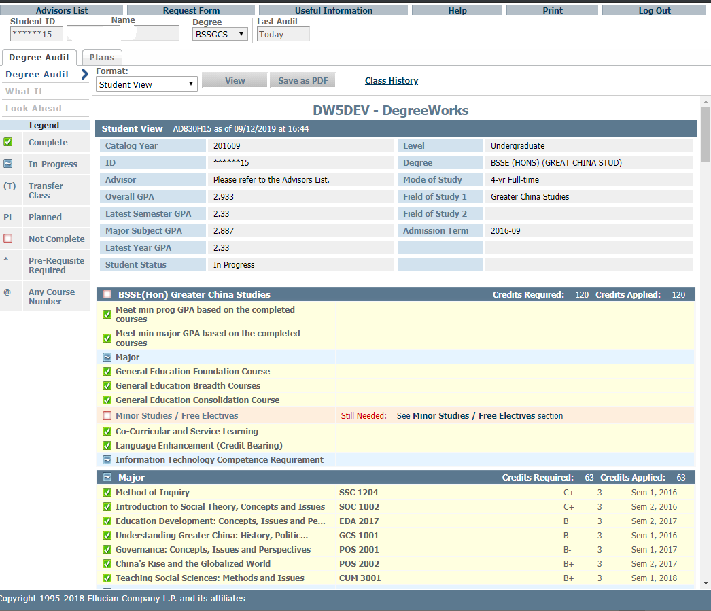
Format: Student View (default)
Student Information
Programme requirement block
Complete
In-Progress
Legend
Not complete
Study Area blocks

Slide 7
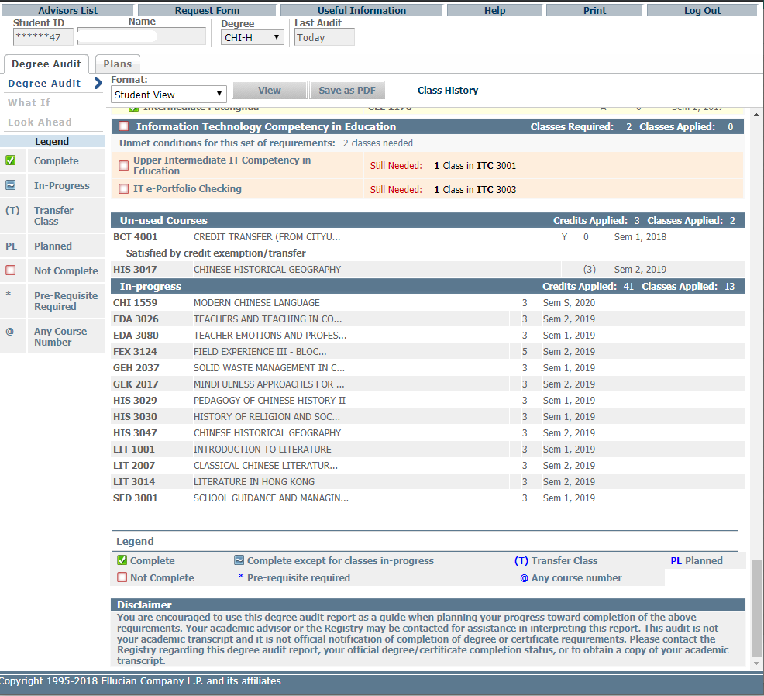
Un-used courses, i.e. courses NOT used to meet any graduation requirements
Misc. Information block
In-progress courses
Legend

Slide 8
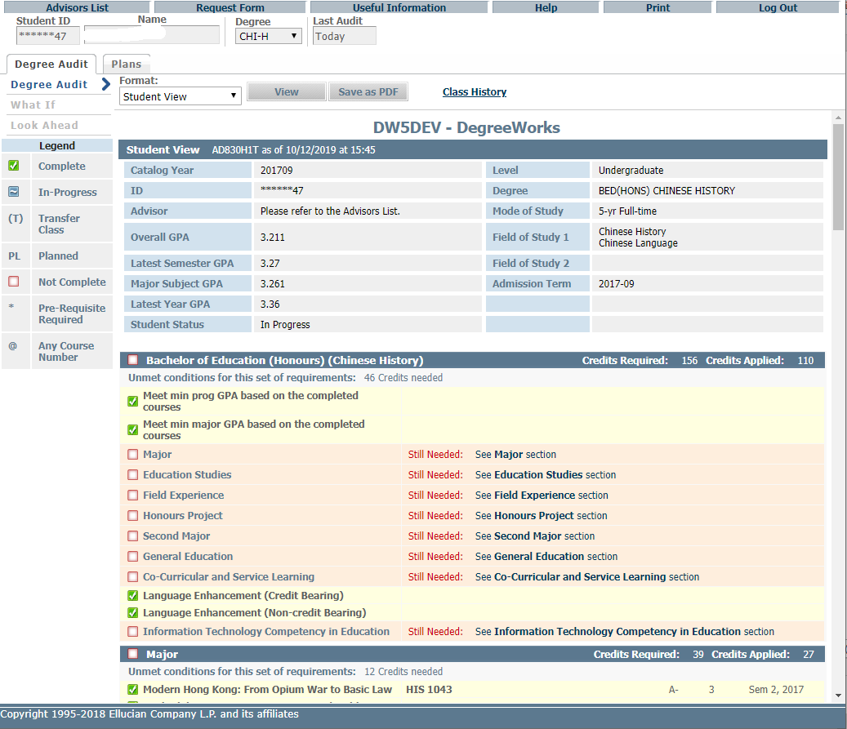
Click “Save as PDF” to save the audit as a PDF

Slide 9
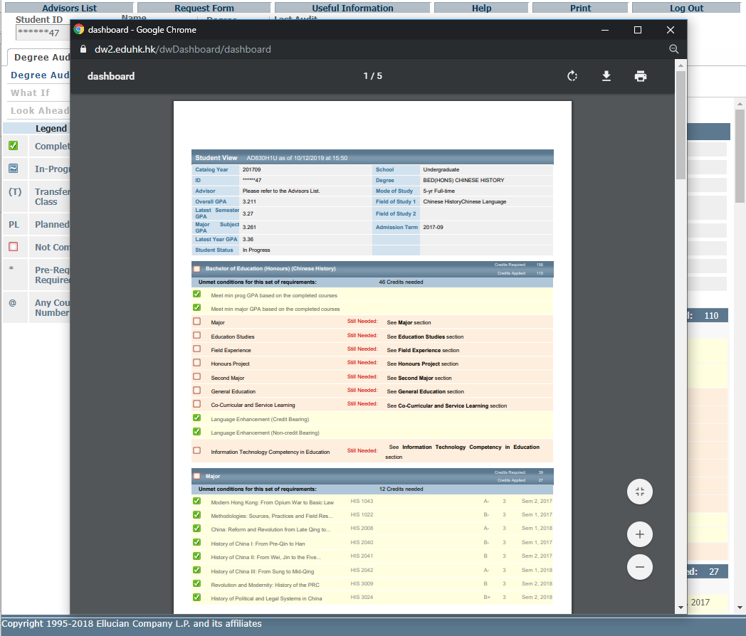
Click to download the PDF file
Click to Print

Slide 10
Features of DegreeWorks – Degree Audit Reports
Format: Registration Checklist
Shows only the unfulfilled requirements that are "Still Needed" on the checklist.

Slide 11
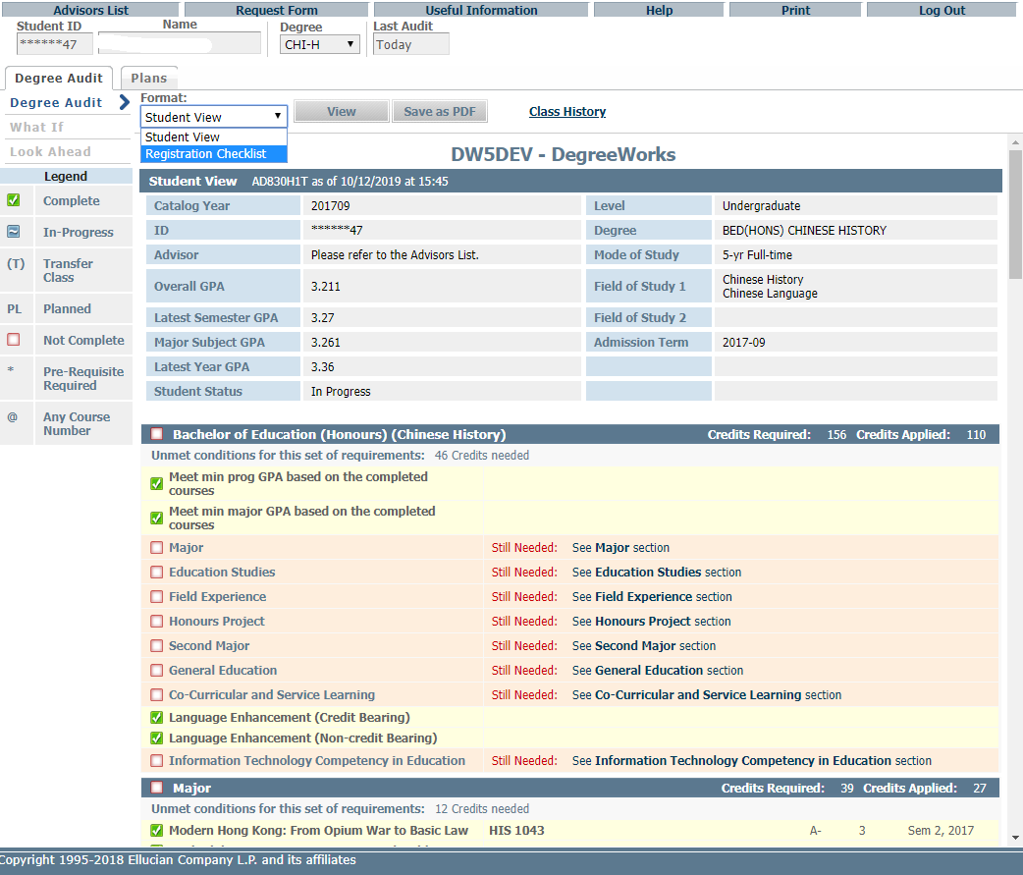
Click on the pull down menu, choose a format and press “View”

Slide 12
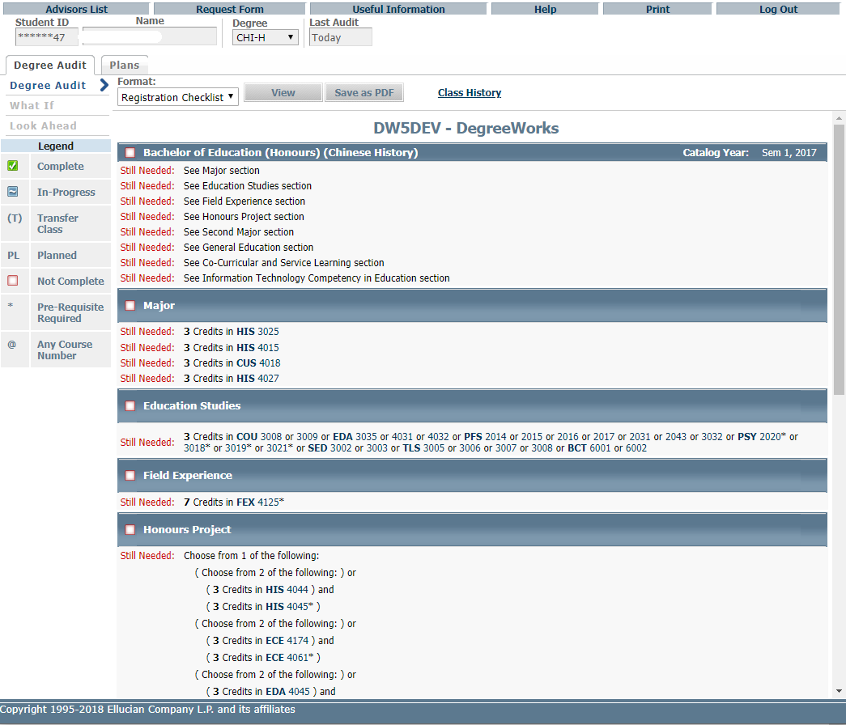
Registration Checklist
Courses still needed

Slide 13
Features of DegreeWorks – Class history
Provides a listing of all of the courses taken by the student, with grades and credits, grouped by the semester taken.

Slide 14
Features of DegreeWorks – Class history
Class History

Slide 15
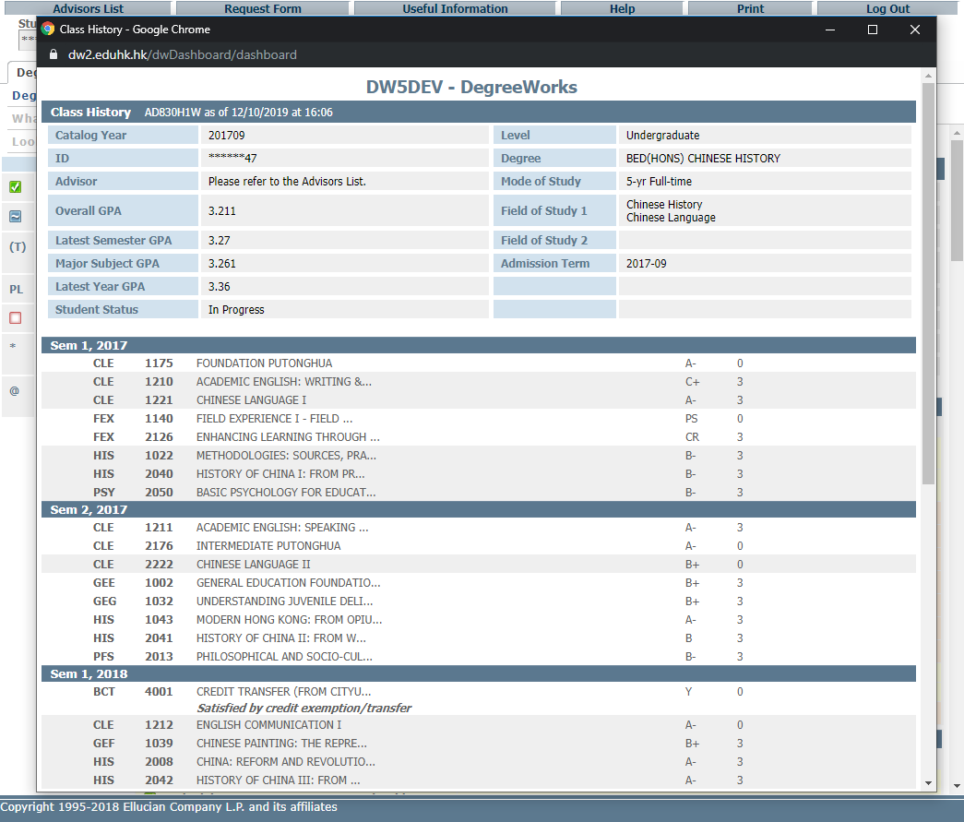
Listing of courses, grades and credits in chronological order

Slide 16
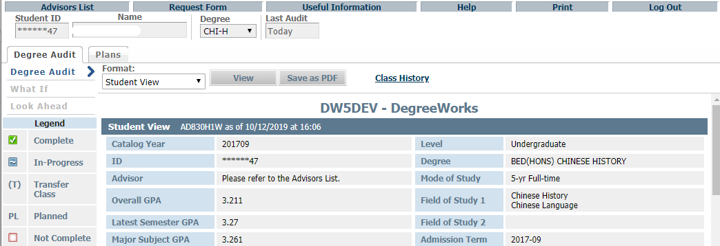
Request for reviewing and updating audit report
If the degree audit report is found incorrect or outdated, students can request the Registry to review and update the record by filling in a DegreeWorks request form which could be downloaded from clicking “Request Form” as follows.

Slide 17
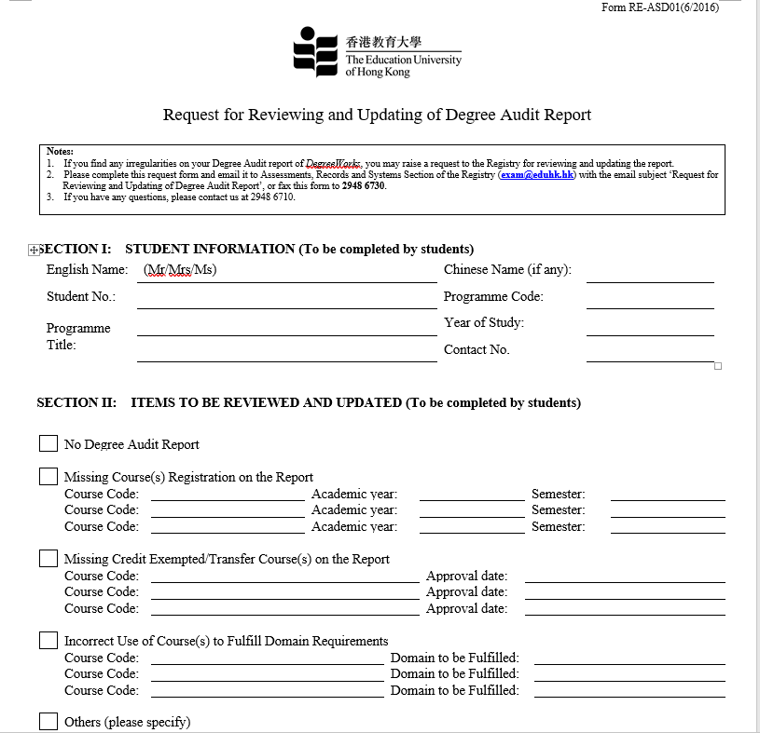
Complete the form and send email to Registry exam@eduhk.hk

Slide 18
Features of DegreeWorks – What If
The “What-if” function shows students how progress towards degree completion changes if they add a Second Major / Minor or change majors. It can also include unregistered classes that the students plan to take in the future.

Slide 19
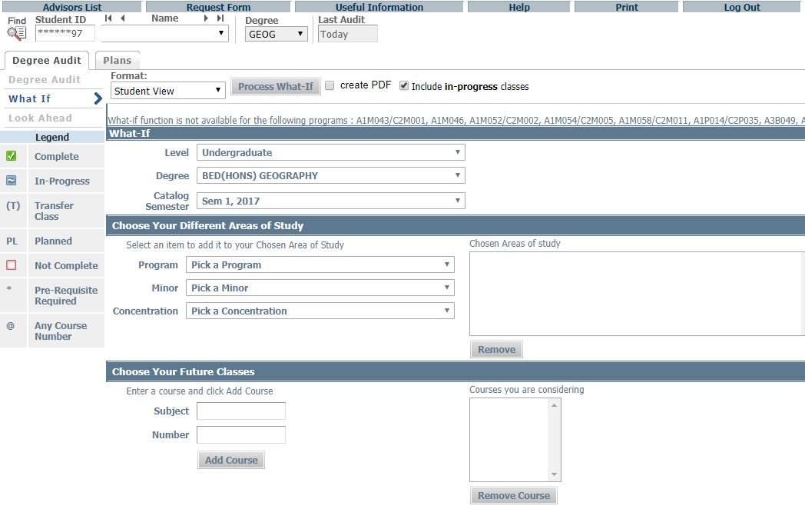
Features of DegreeWorks – What If
What If

Slide 20
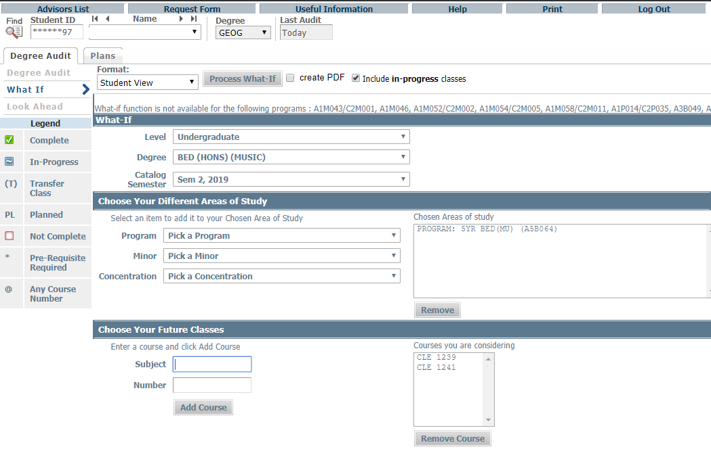
Click Process What-If
Chosen Areas of study show up here
Choose level, degree, catalog semester, program and major, minor and concentration where applicable
Enter subject code and number, click Add Course
Chosen Courses show up here

Slide 21
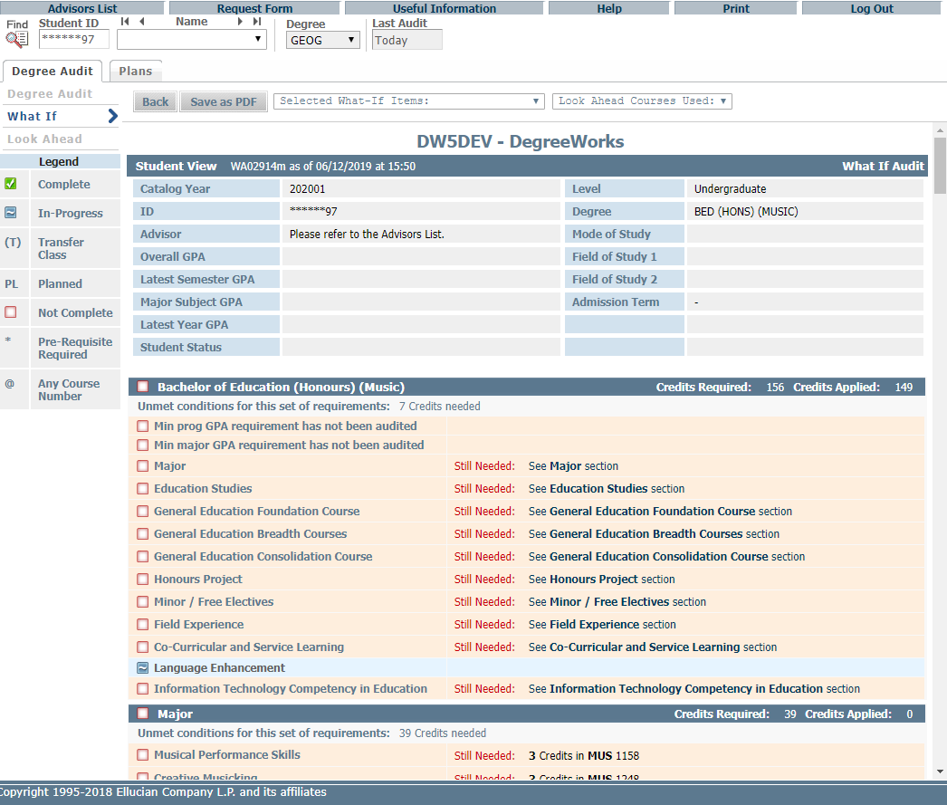
The “What-if” audit shows students how progress towards degree completion changes if they add a Second Major / Minor or change majors.

Slide 22
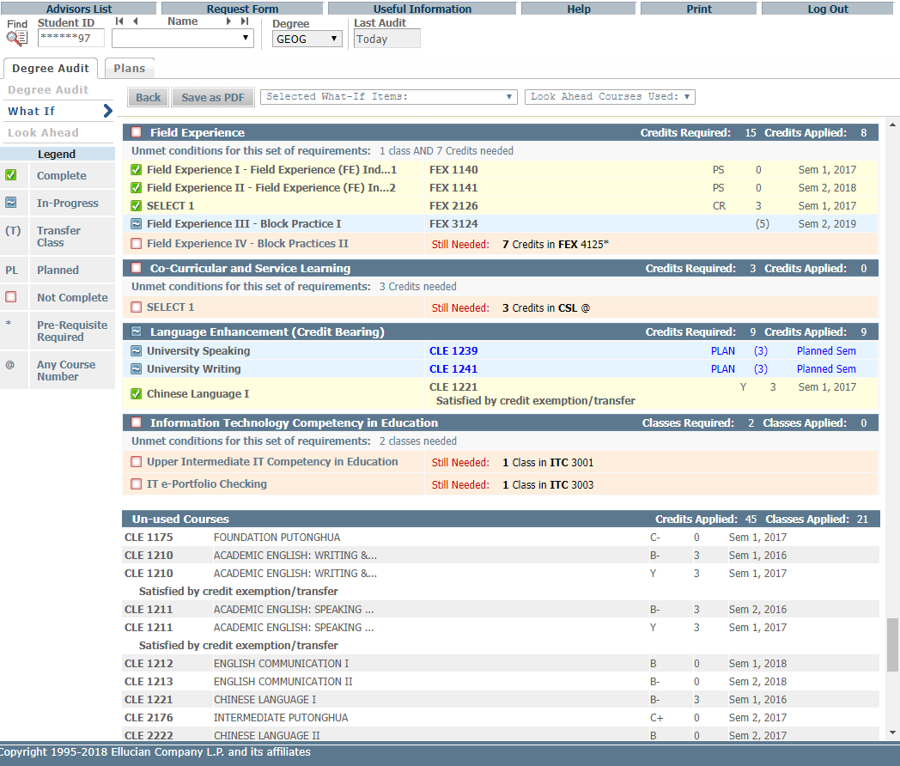

Slide 23
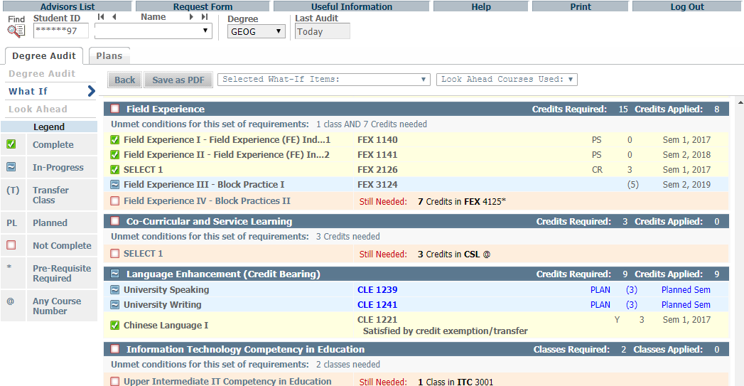
Click Save as PDF button to save/print What-If Audit
What-If Audits are not stored in the database. After they are run, the results can be saved or printed using the Save as PDF button. Navigating away from What-If screen the audit cannot be accessed again. It is possible to run another What-If Audit with the same parameters.
Click “Save as PDF”

Slide 24
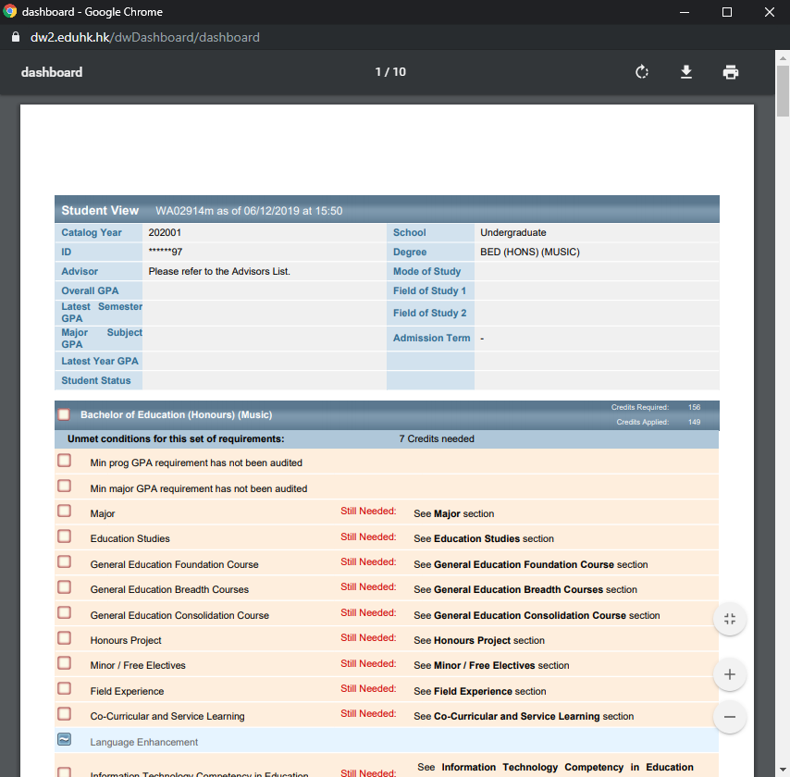

Slide 25
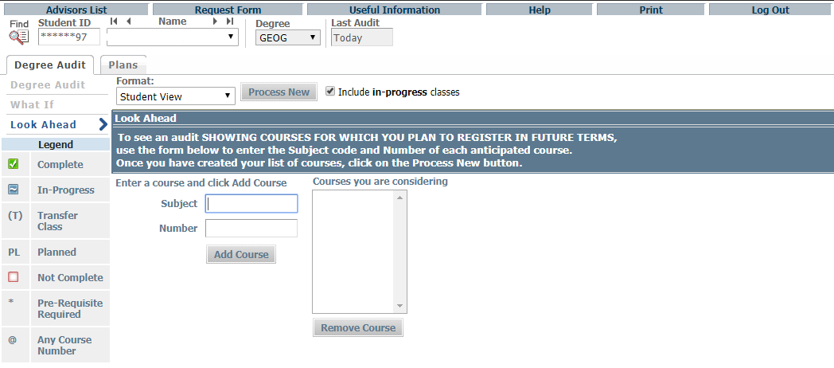
Features of DegreeWorks – Look Ahead
The Look Ahead allows the audit to include unregistered classes the student plans to take in the future.
Look Ahead

Slide 26
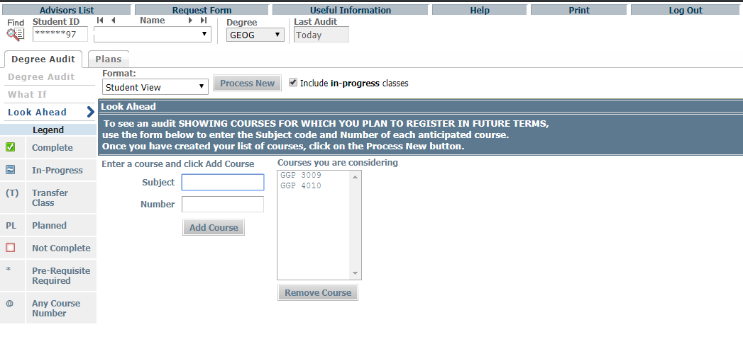
Repeat entering subject(s) and number(s), if needed.
Click Process New
Chosen Courses show up here
Enter subject code and number, click Add Course

Slide 27
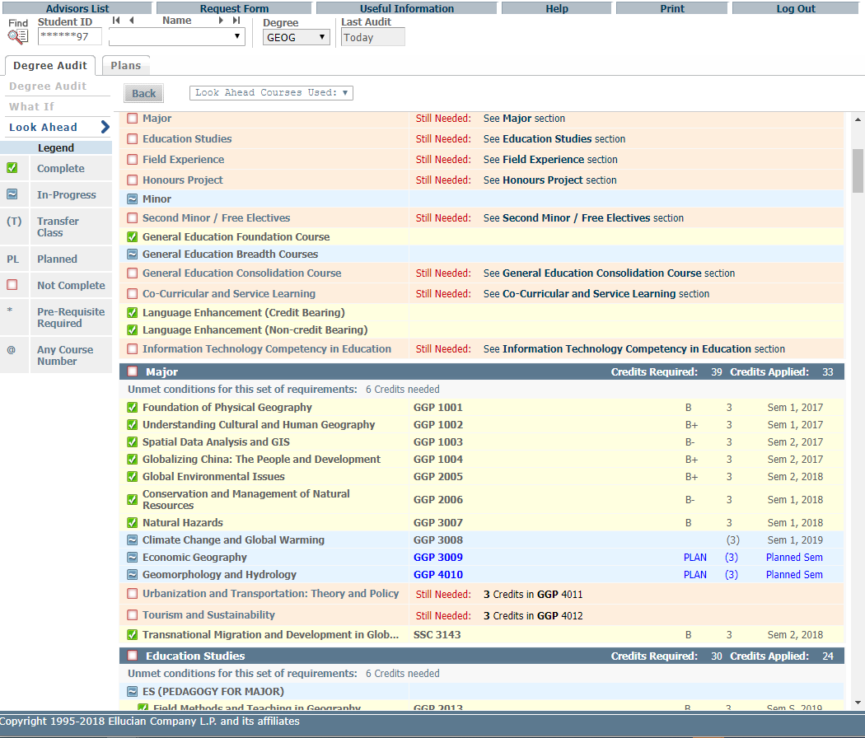
Courses will be marked with “Planned Sem” in the Look Ahead Audit report.

Slide 28
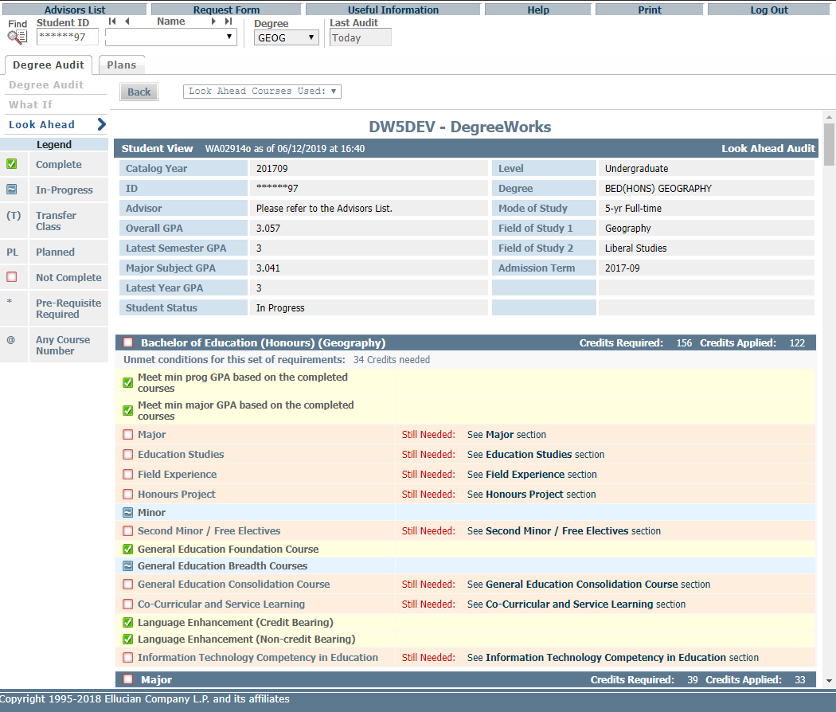
It is important to remember that these Look Ahead audits are not saved, but can be printed and run again.
Print

Slide 29
Features of DegreeWorks – Student Educational Planner (SEP)
Why is having a study plan important?
A learning tool: Through working on their study plan, students can understand the overall requirements of the programs and how to meet the graduation requirements.
A self-evaluation tool: In the process of creating a plan, students can estimate how many courses they want to take in each semester and judge whether they are able to balance the class load with other obligations in their study.
A road map to academic success: Students with an academic plan have a clear direction and understanding of how to complete their programs.
For details, please visit https://www.eduhk.hk/advising.
Important Note: The old DegreeWorks 4 supported a total of 50 lines of Notes per plan, each line with a maximum of 72 bytes, including spaces at the end of lines. That’s a total of 3600 bytes. And the all-over max size of the plan, including all course information and notes, is 10K. The new Student Educational Planner (SEP) in DegreeWorks 5 does not have these limitations.

Slide 30
Features of DegreeWorks – Student Educational Planner (SEP)
Edit View

Slide 31
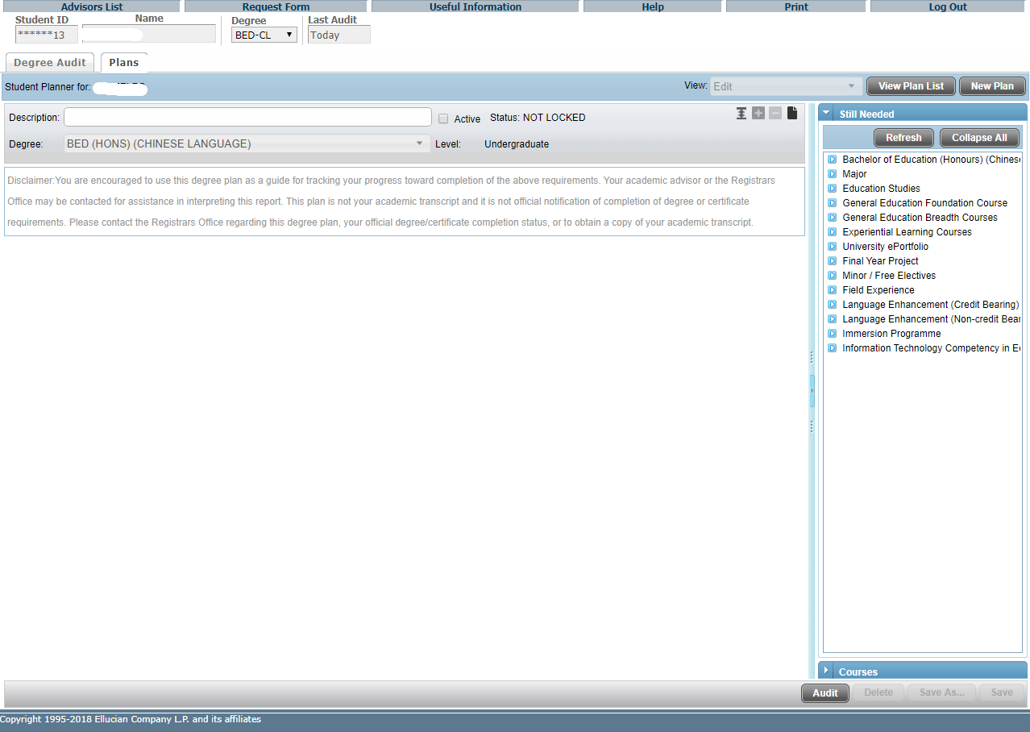
Click “Plans” tab to access the Student Educational Planner (SEP)
With Edit View as the default view, student records with no plan in place, as well as student records with one or more plans in place, will see their plan or plans in Edit View. The student cannot have more than 1 active plan.
The right-hand panel of the Edit view provides options for “dragging and dropping” coursework to the plan. The “Still Needed” view provides course information from the student audit, whereas the “Courses” view provides a Catalog inventory listing. These can be especially helpful when starting from a blank plan.
An unlimited number of notes can be added to requirements, terms or to the overall plan.

Slide 32
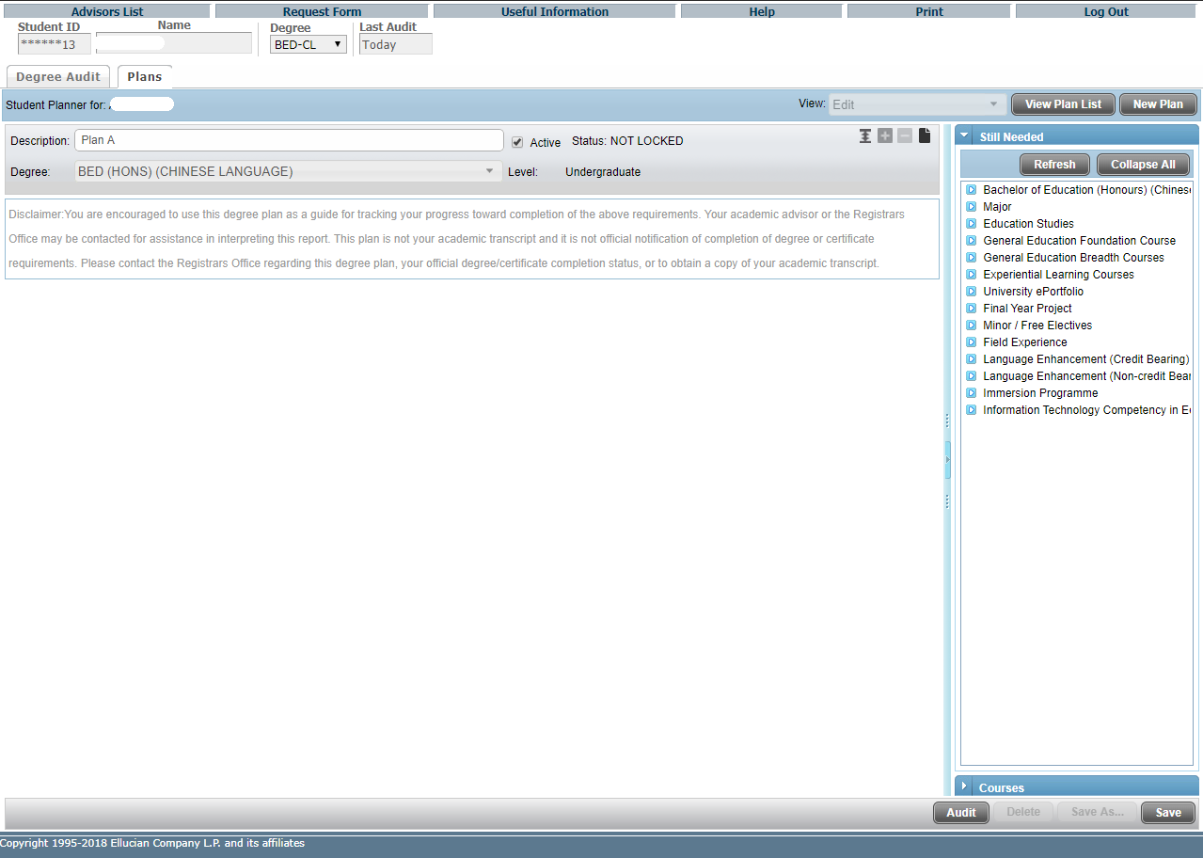
To add a plan, type the name, e.g. Plan A, in the Description.
Students can only have one Active Plan. Check to activate the current plan. Old / outdated plans should not be marked Active.

Slide 33
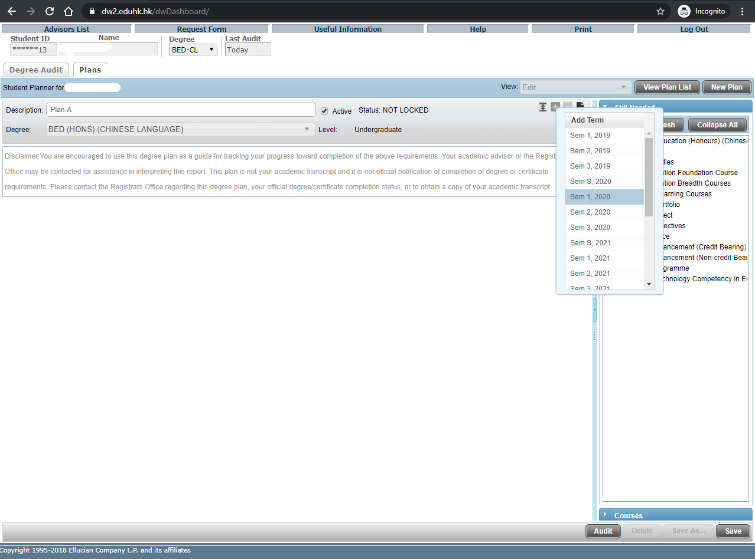
If you need to add terms to your SEP plan that are not already included, you can do that by clicking the “Add Term” button.
After clicking the button, you simply click the term you wish to add, and the term will be inserted accordingly.

Slide 34
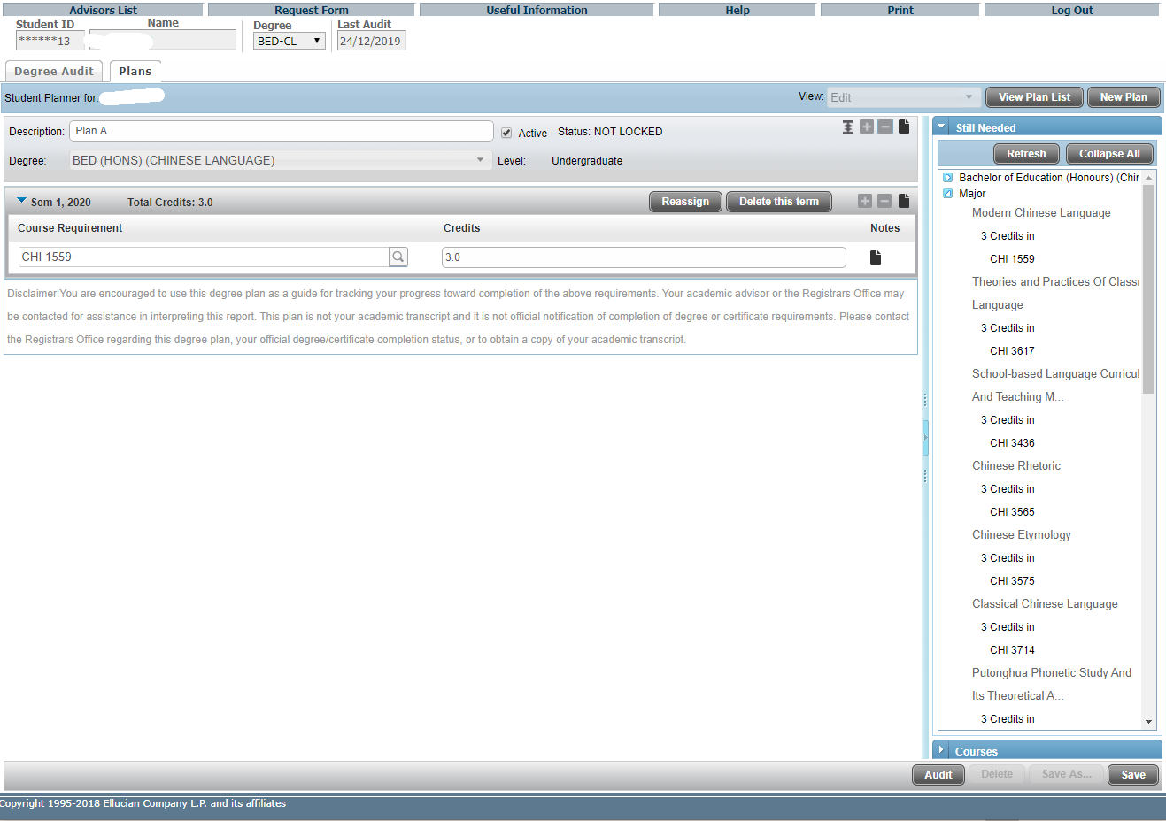
If you need to delete a term in SEP plan, you can do that by selecting that term and clicking the “Delete selected term” button.

Slide 35
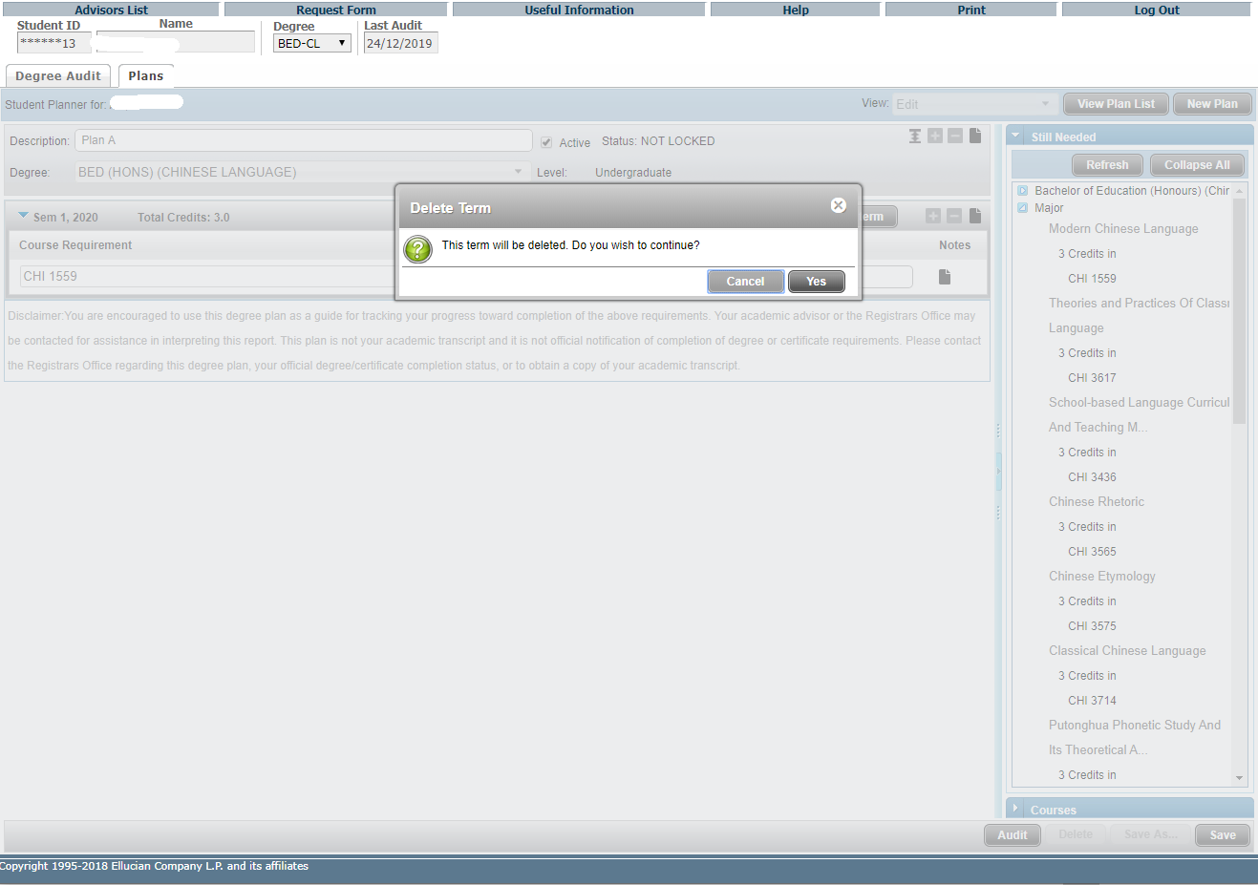
Click “Yes” to confirm the deletion.

Slide 36
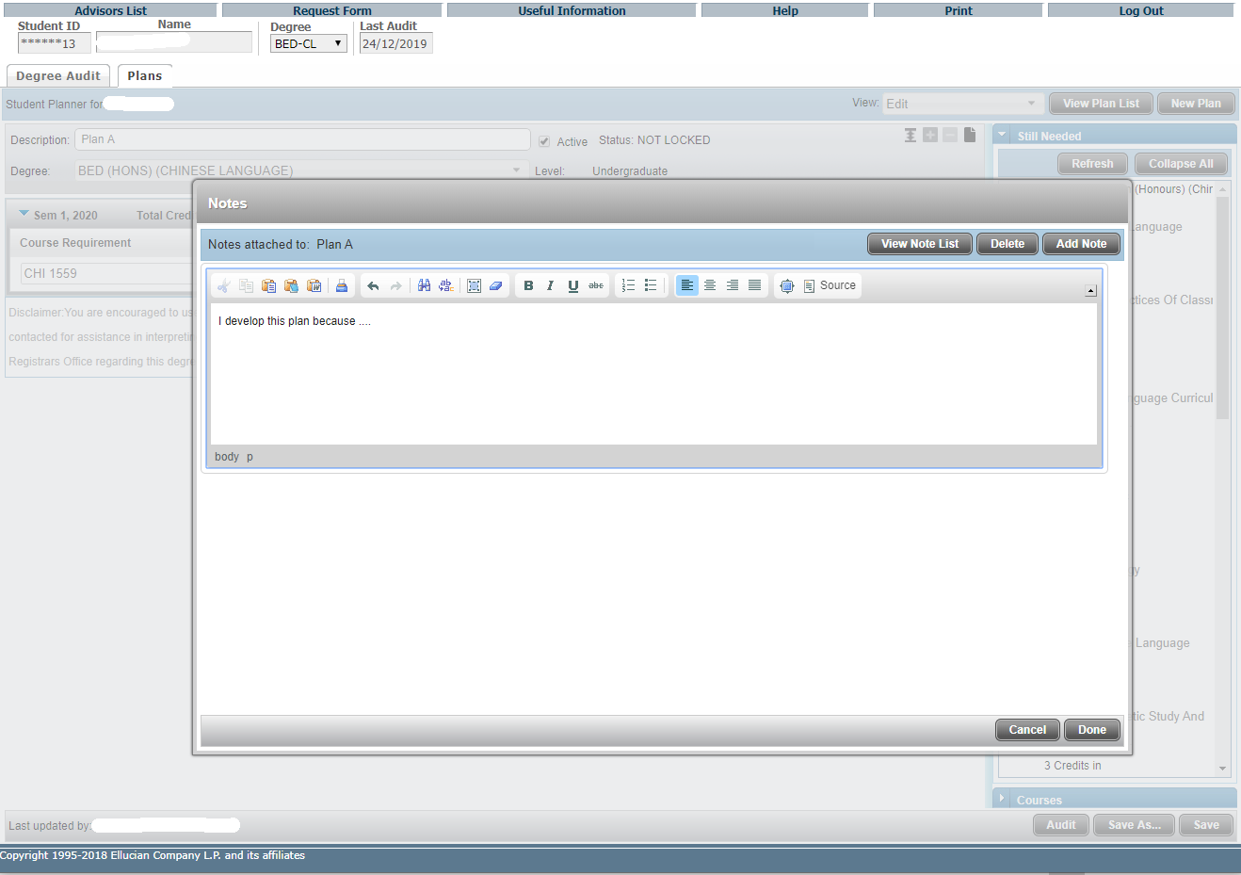
You can explain your plan in Plan-level notes (English only) using this button to add a note or edit/delete notes you have created.
After clicking “Add Note”, you can type your text in English and then click “Done” to finish.

Slide 37
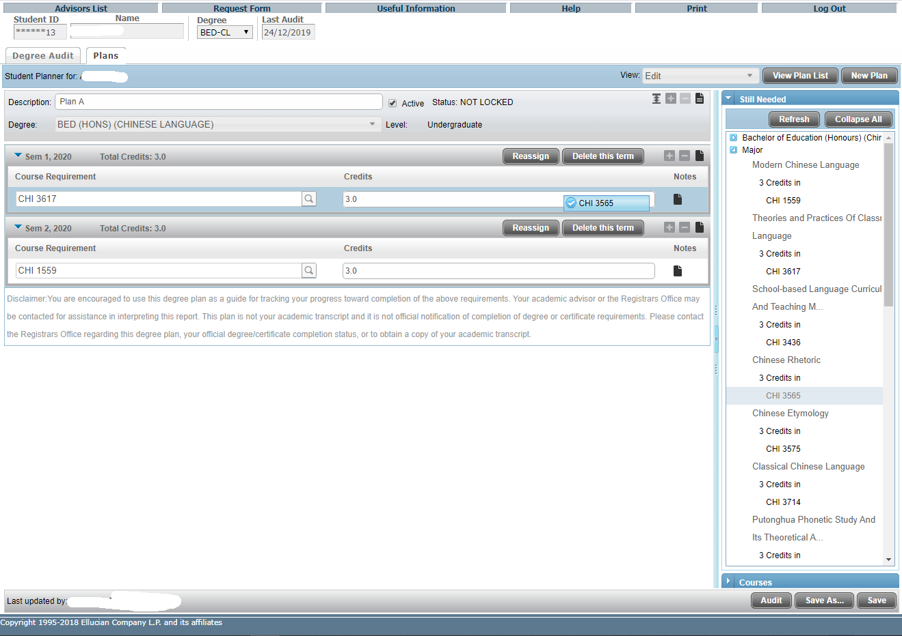
Drag and drop the course “CHI 3565” onto “Sem 1, 2020”.
Course Requirement from either the “Still Needed” list or the “Courses” list can be dragged and dropped into a term on the plan.

Slide 38
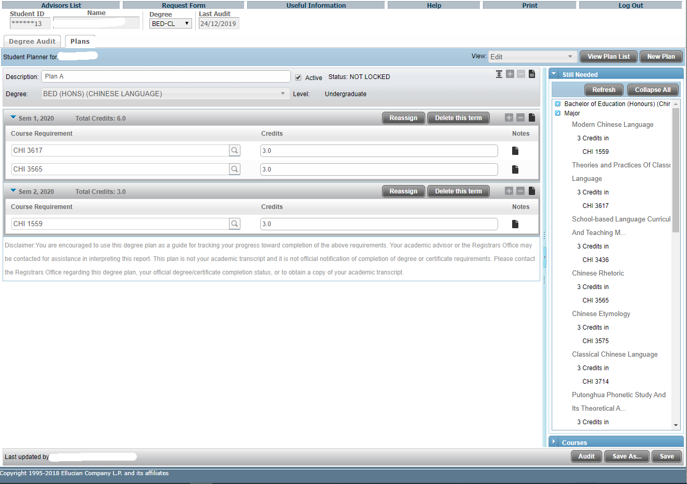
The course requirement “CHI 3565” will be inserted into “Sem 1, 2020”.

Slide 39
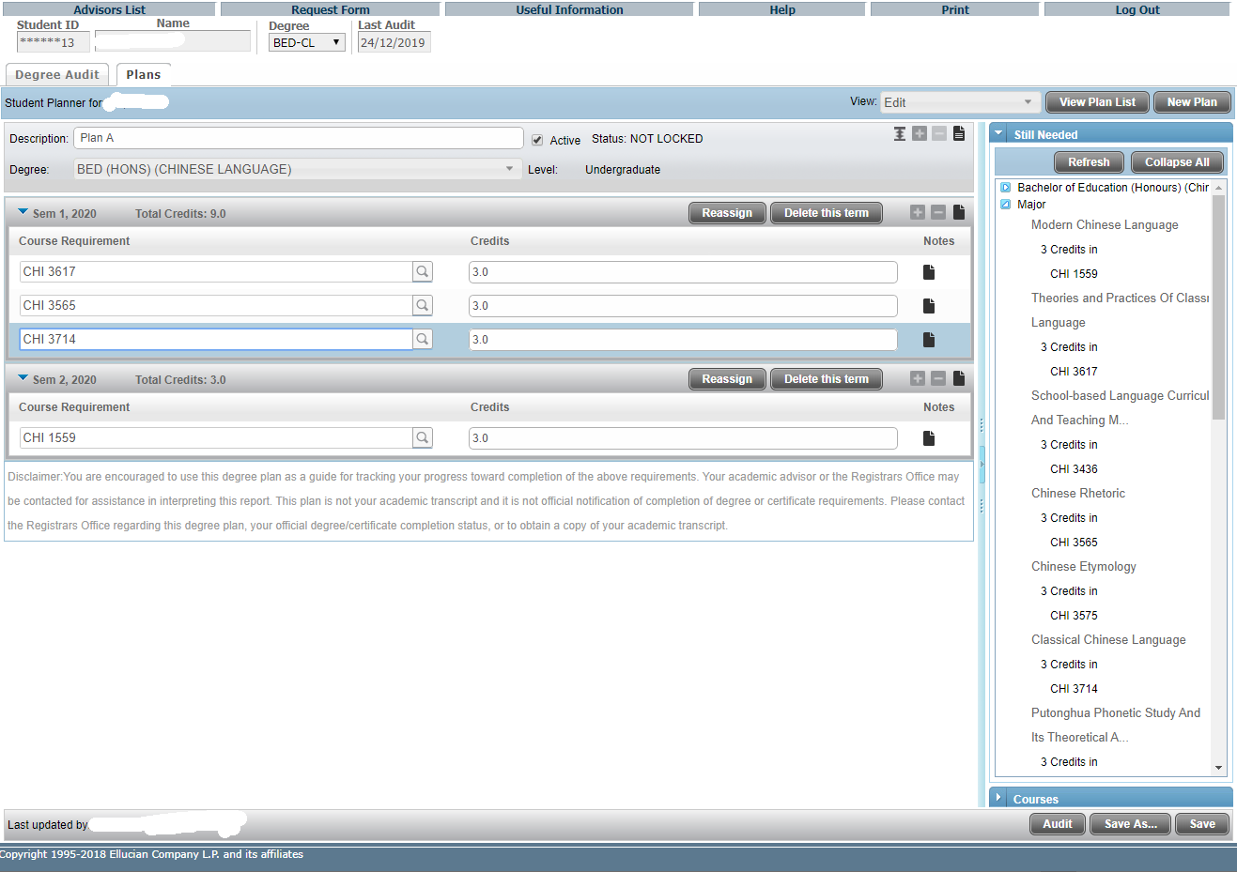
You can add / delete term requirements using these buttons.
Type the course code after clicking the “add requirement” button.

Slide 40
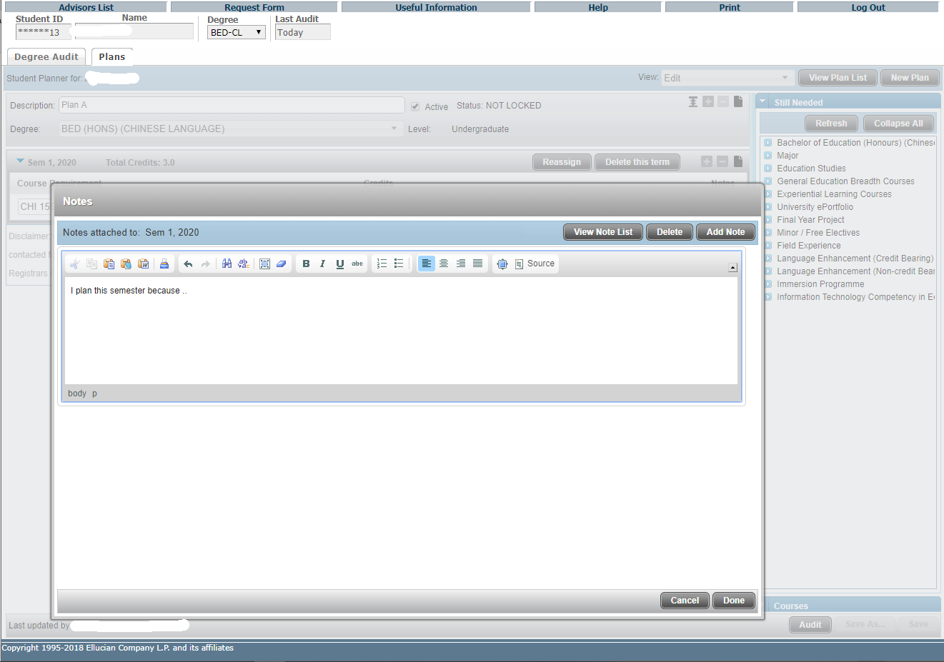
You can explain your term plan in term-level notes (English only) using this button to add a note or edit/delete notes you have created.
After clicking “Add Note”, you can type your text in English and then click “Done” to finish.

Slide 41
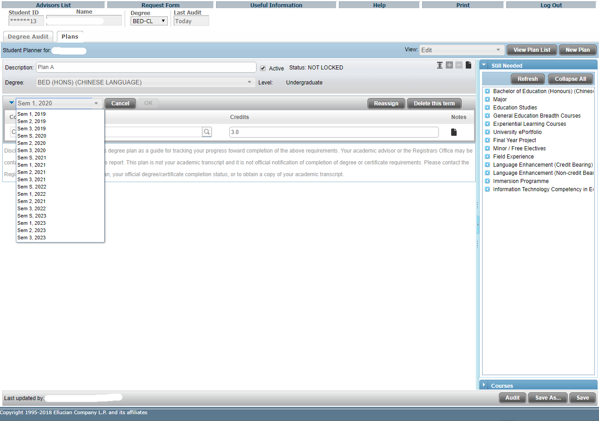
The Reassign button allows you to reassign all term requirements to a different term.
Select the term and then click “OK” to finish.

Slide 42
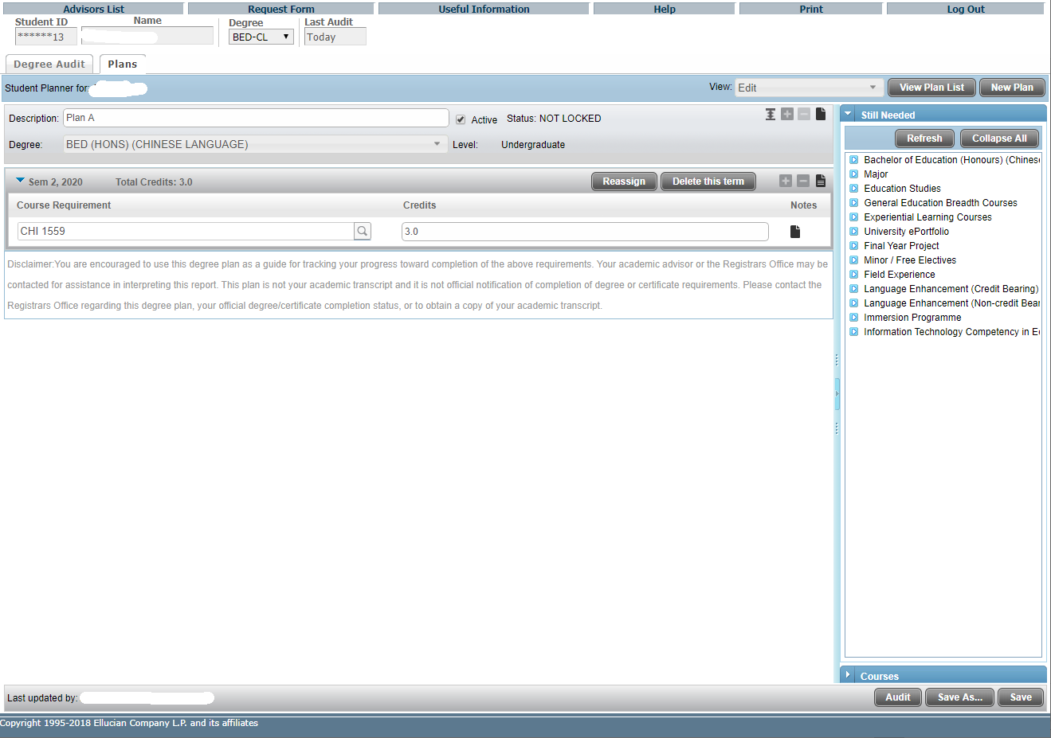
All term requirements are re-assigned to a different term.

Slide 43
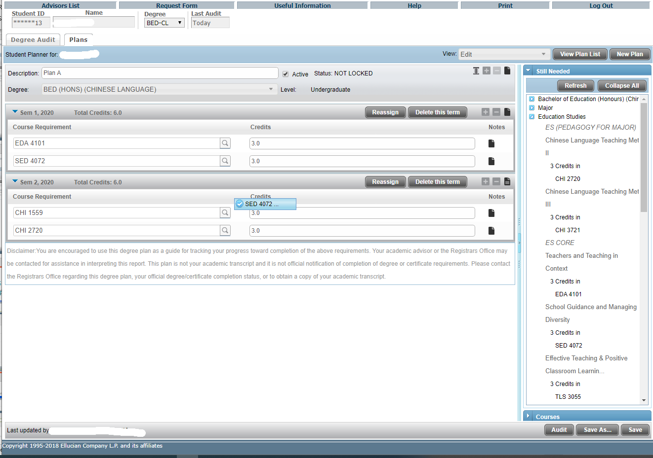
Moving the course from Sem 1, 2020 to Sem 2, 2020.
Individual requirements can be “dragged and dropped” from term to term if needed.

Slide 44
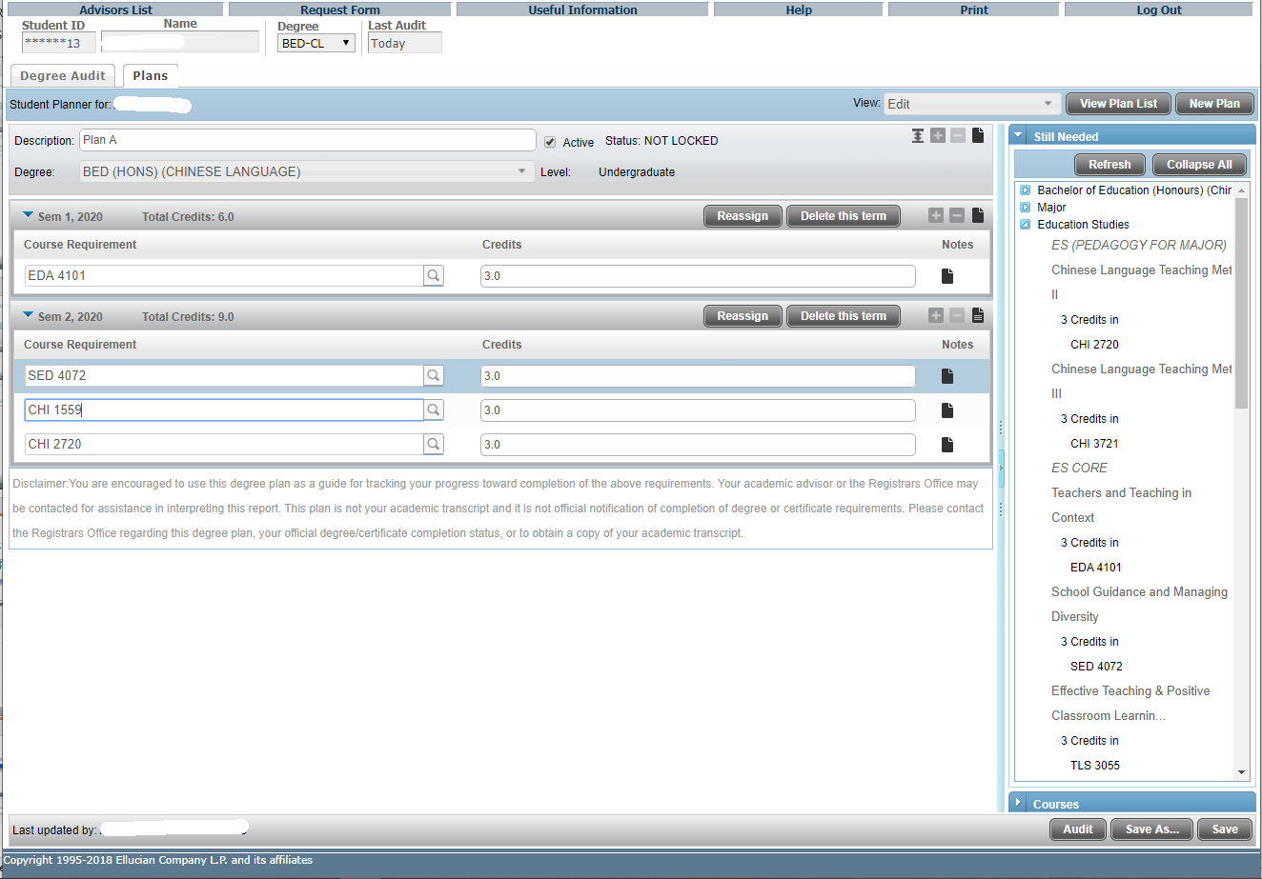
The course is moved from Sem 1, 2020 to Sem 2, 2020.

Slide 45
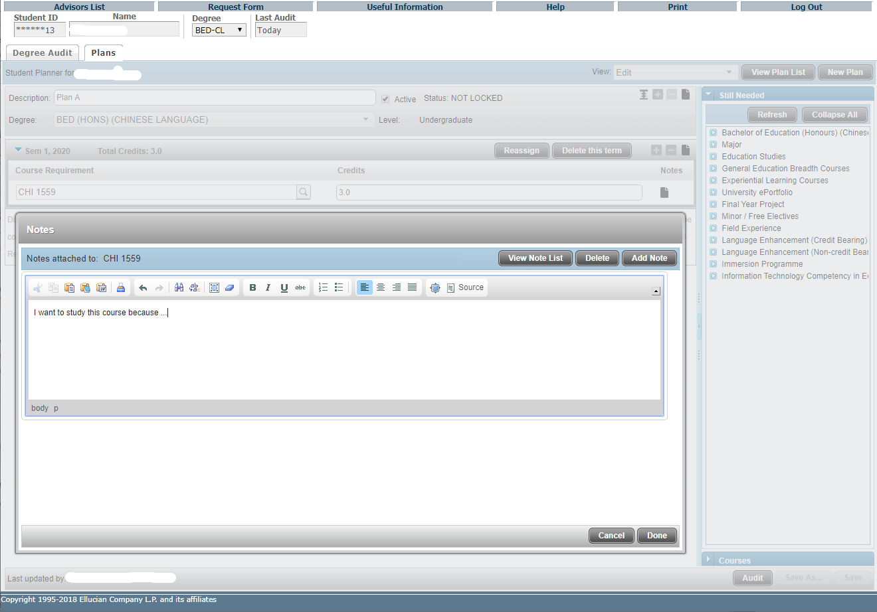
You can explain your course requirement plan in requirement notes (English only) using this button to add a note or edit/delete notes you have created.
After clicking “Add Note”, you can type your text in English and then click “Done” to finish.

Slide 46
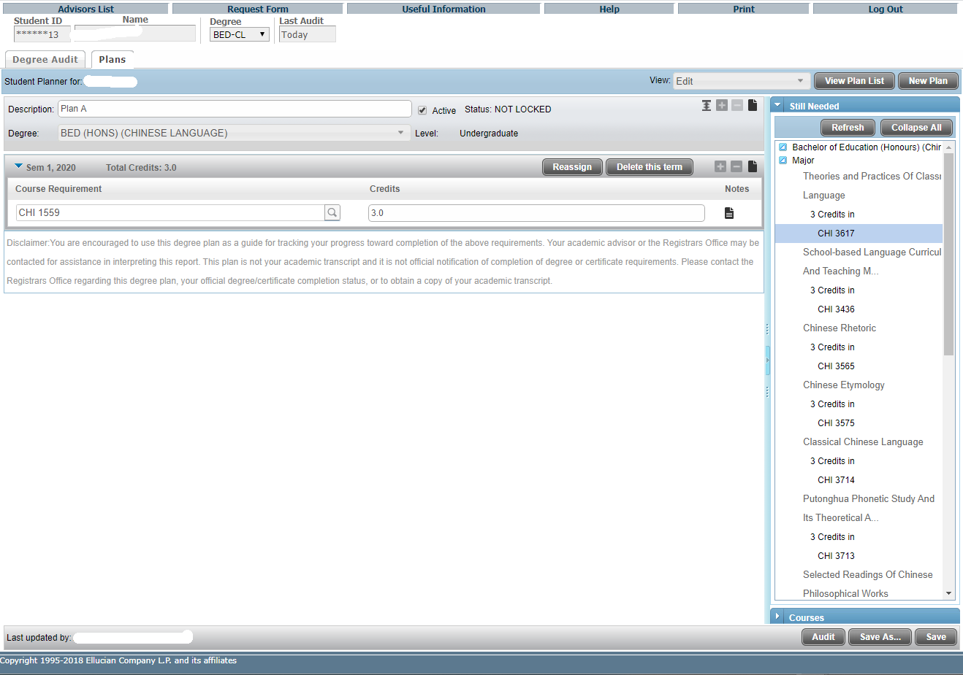
After making any changes to a Plan in Edit View, save those changes and then click on the Audit button in Edit View before leaving this View.
Or click “Save As …” if you want to save it as another plan instead of overwriting.

Slide 47
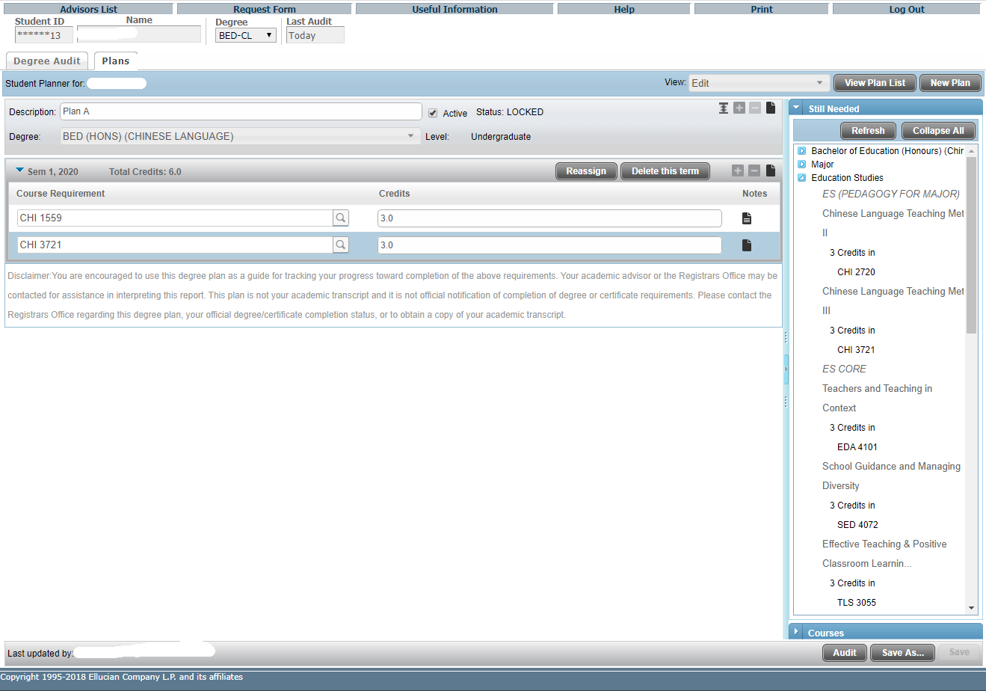
Your advisor can prevent you from making further changes to a plan by locking.
From that point forward, you can only click "Save As ..." to save it as another plan. Alternatively you may consult your advisor to unlock the current plan and make changes.

Slide 48
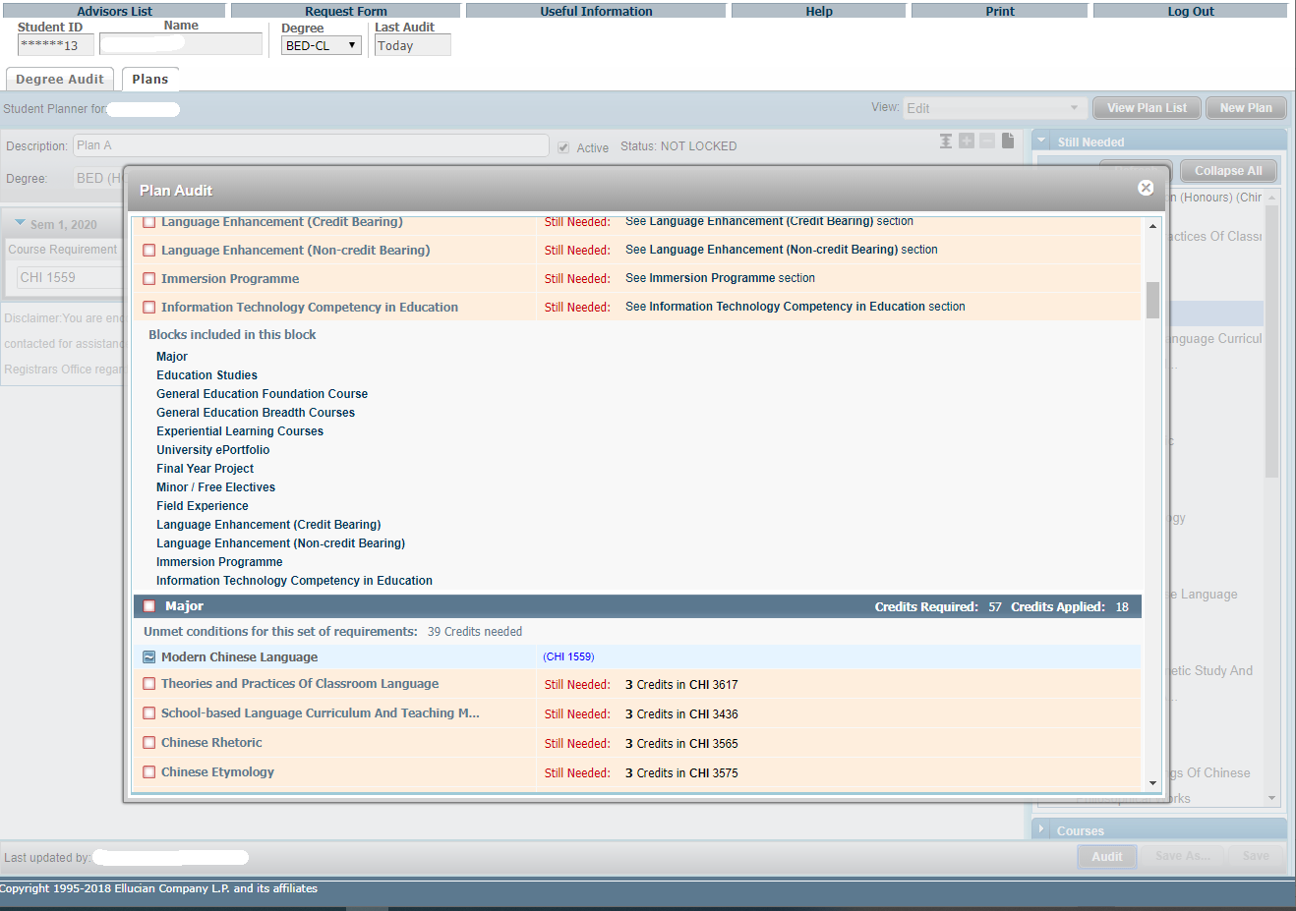
As soon as a plan opens in Edit View, click the Audit button to generate a Plan Audit, which will display all courses from the Plan in an advising worksheet in an imbedded window.
The planned requirements are highlighted.

Slide 49
Features of DegreeWorks – Student Educational Planner (SEP)
View Plan List

Slide 50
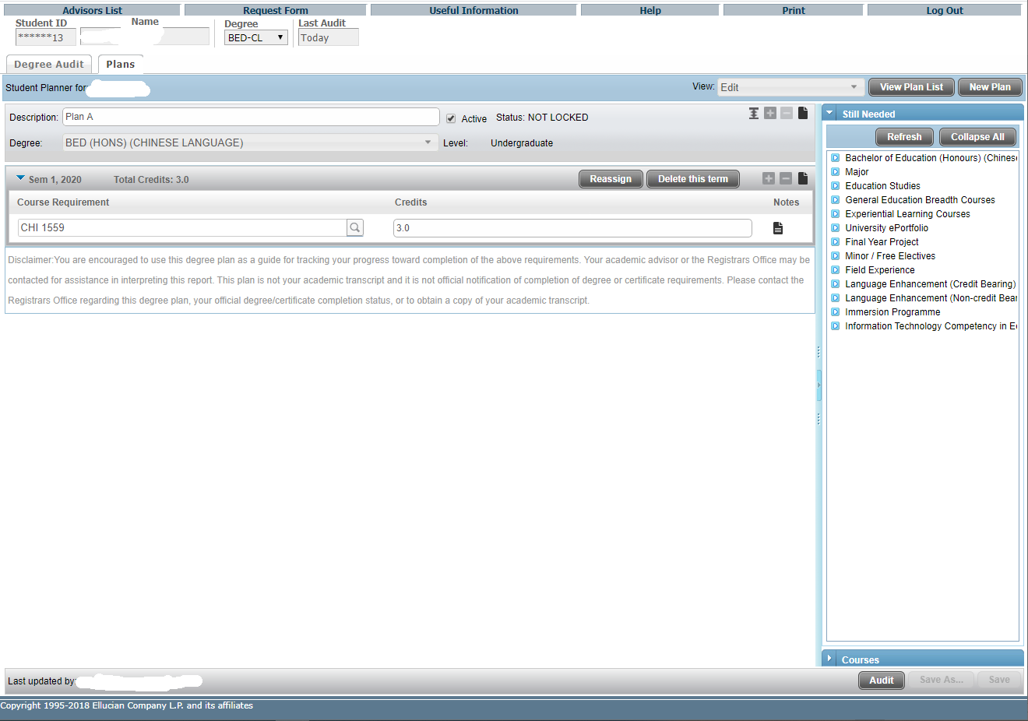
To create a new plan, click “New Plan” button.
Click “View Plan List” to view the list of your plan(s).

Slide 51
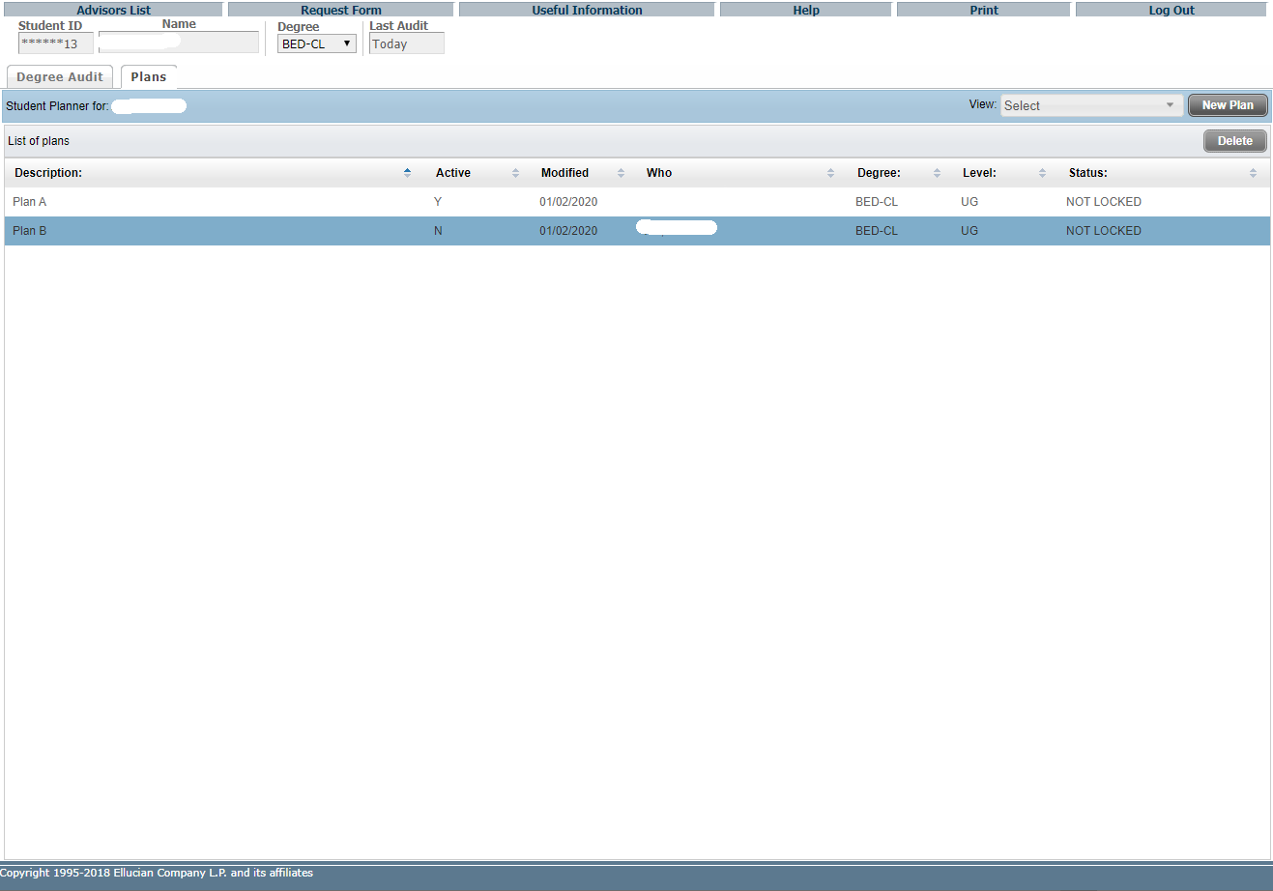
To delete an un-used plan, click to select the plan.
Click “Delete” button and then “Yes” to confirm to permanently delete the plan.

Slide 52
Features of DegreeWorks – Student Educational Planner (SEP)
Calendar View

Slide 53
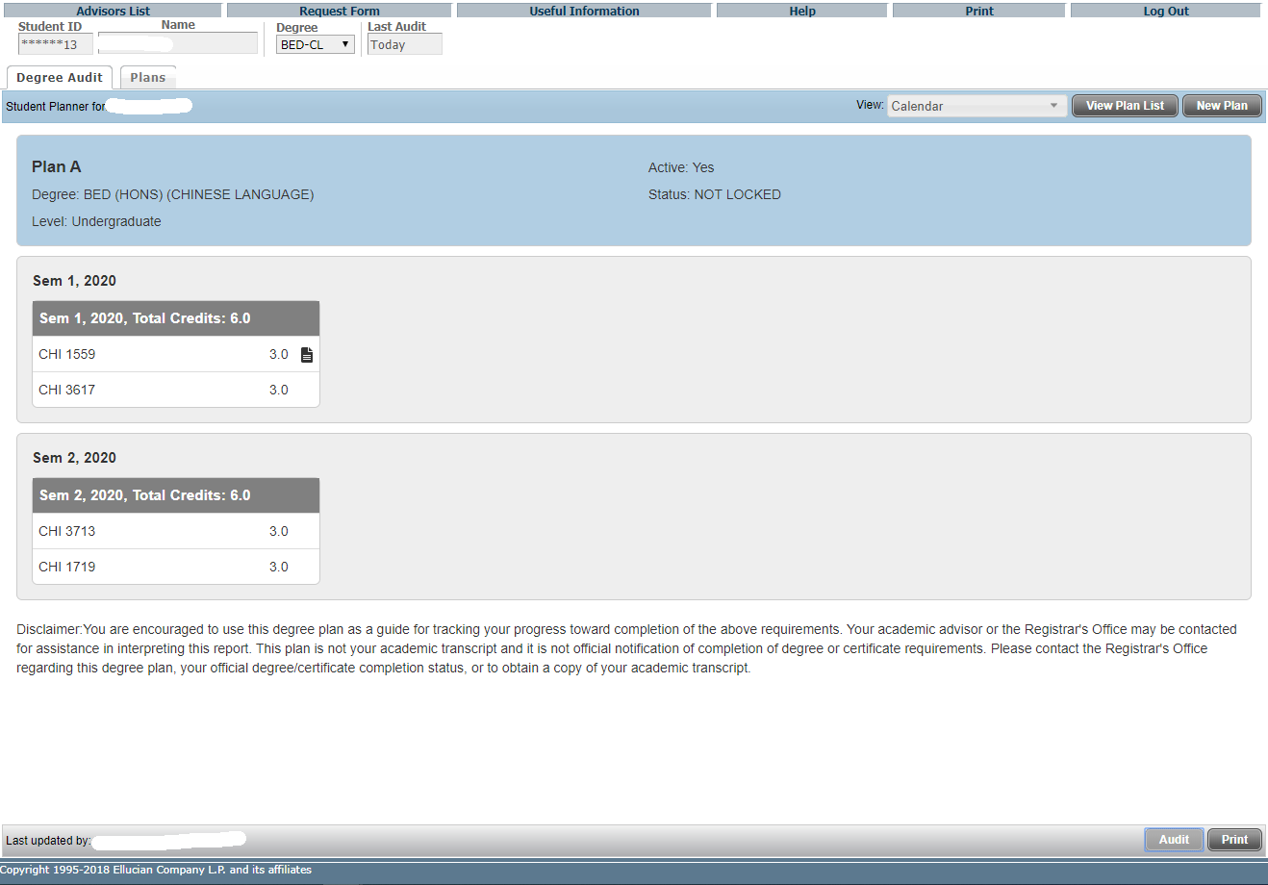
The Calendar view allows the user to view a plan in a view-only calendar presentation that is suitable for printing.
No editing of the plan is available in this view.
Click “Print” button for printing.

Slide 54
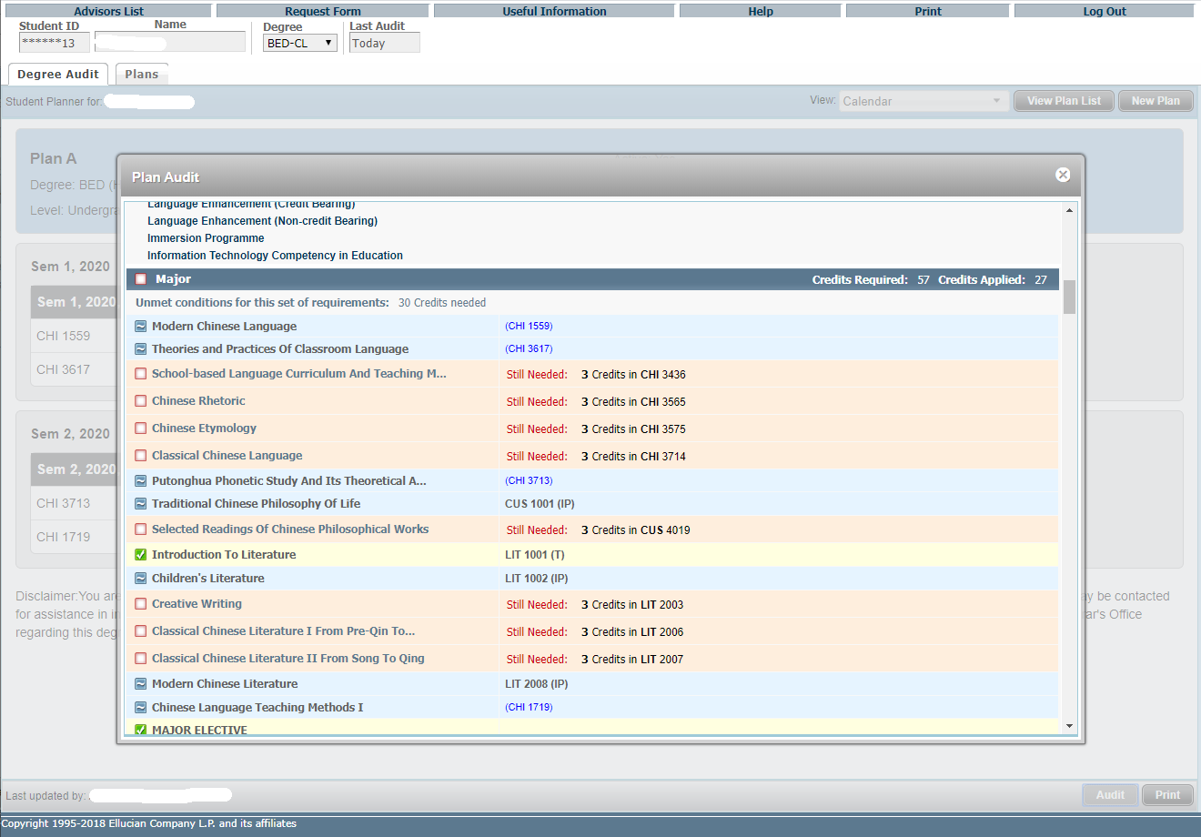
In Calendar View, click the Audit button to generate a Plan Audit, which will display all courses from the Plan in an advising worksheet in an imbedded window.
The planned requirements are highlighted.

Slide 55
Features of DegreeWorks – Student Educational Planner (SEP)
Notes View

Slide 56
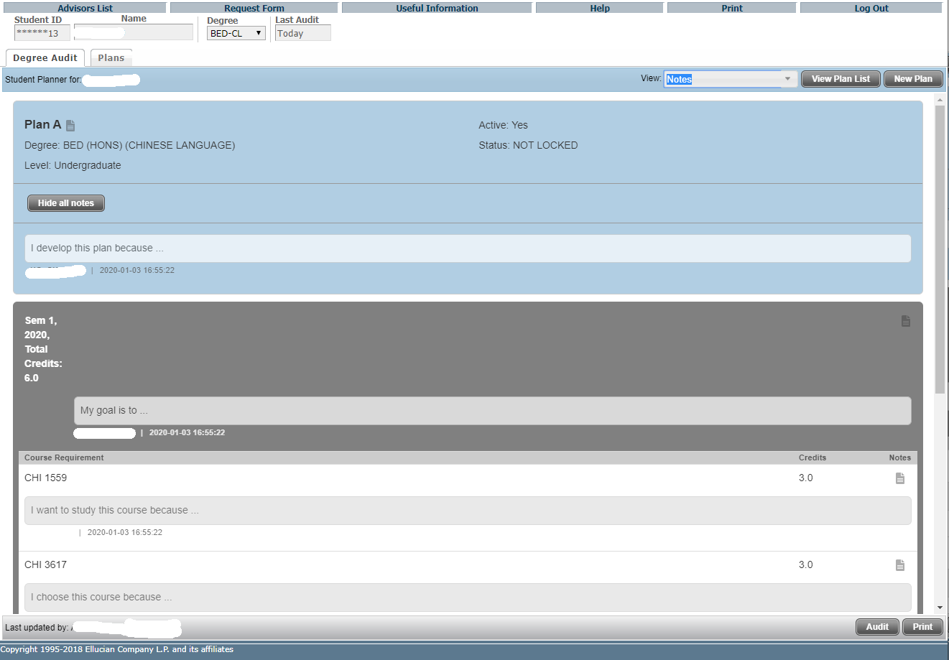
The Notes view allows the user to view a plan in a comprehensive view-only presentation that is suitable for printing, with or without notes inline. No editing of the plan is available in this view.
In the Expanded mode, plan, term and requirement notes display underneath the corresponding item, and will be included when printing. Click “Print” for printing.

Slide 57
Click “Hide all notes” to enter Collapsed mode.

Slide 58
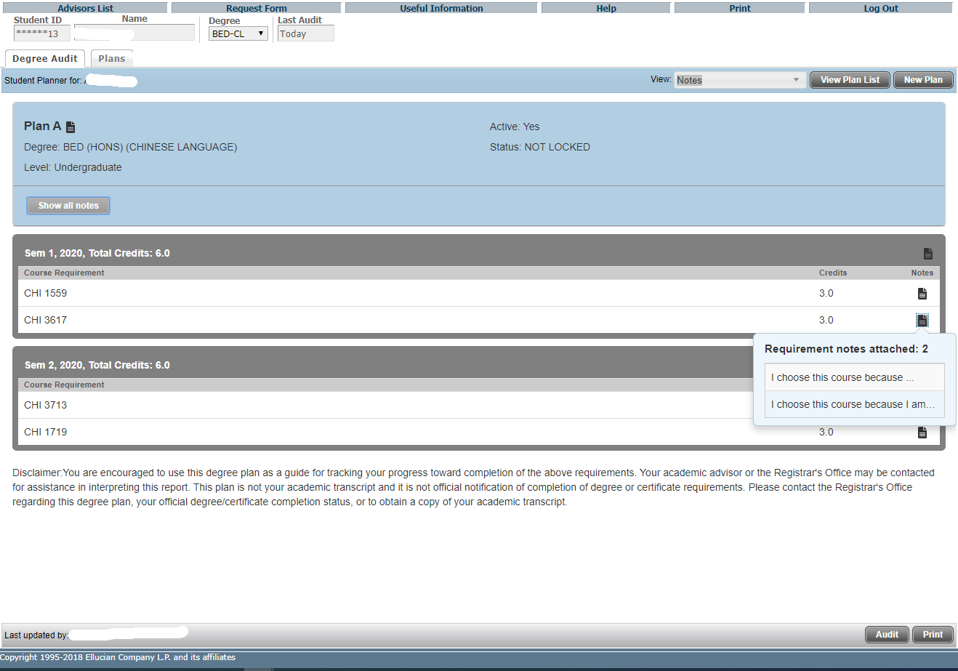
In the Collapsed mode, a note icon will display to the right of that item, but note text will not be included when printing.
Hovering over this icon will show a note preview, and clicking on this icon will open the Notes window.

Slide 59
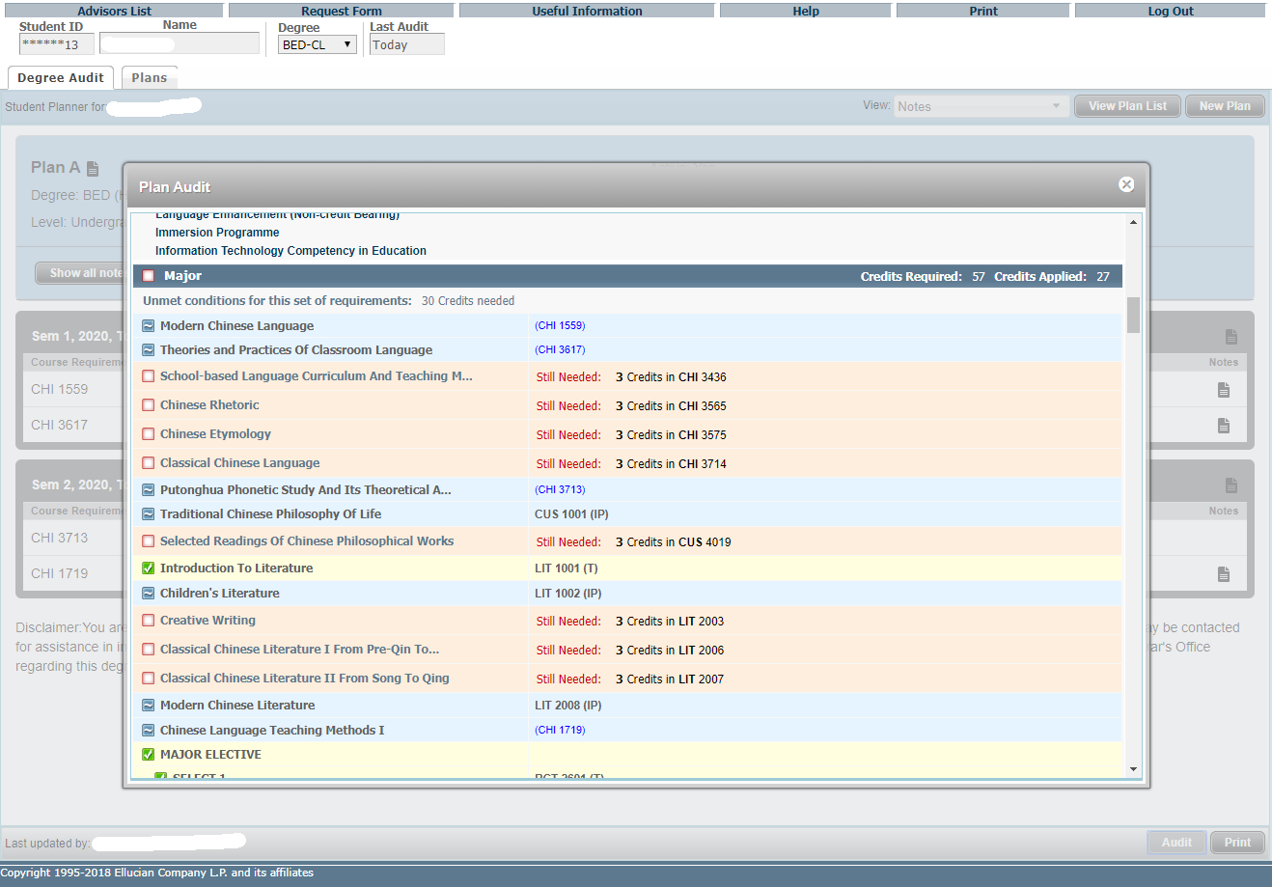
In Notes View, click the Audit button to generate a Plan Audit, which will display all courses from the Plan in an advising worksheet in an imbedded window.
The planned requirements are highlighted.

